Slide 1
Simple steps into engaging a large class
Dr Enoch Chan PhD, FHEA, AFANZAHPE
Lecturer, SClinMed & SBMS
Coordinator of SIMHSE in EdTech, HKUMed

Slide 2
About myself
Lecturer, SClinMed and SBMS, HKU (2023 - current)
  UG teaching in Physiology and Biochemistry (MBBS, BPharm, BBiomedSc and etc.)
  Coordinator of educational technology and students-as-partners initiatives
Awards
  Faculty Teaching Medal, LKS Faculty of Medicine, HKU (2024)
  Early Career Teaching Award, HKU (2023)
Background
  BSc (Hons) in Applied Biology with Biotechnology, PolyU, Hong Kong (2010)
  PhD in Pathology, UNSW Sydney, Australia (2017)
  PgCert in Digital Education, University of Edinburgh, UK (2021)
  PgCert in Medical Education, University of Dundee, UK (ongoing)
Past roles
  Biomedical Educational Developer, UNSW Sydney, Australia (2017-2019)
  E-learning Instructor (Senior RA), LKS Faculty of Medicine, HKU (2019-2021)
  Assistant Lecturer, SClinMed, LKS Faculty of Medicine, HKU (2021-2023)

Slide 3
Icebreaker
faculty
Years of exerpeicne

Slide 4
Overview
Cognitive load theory
Planning lectures / instructional videos
Audience response system
  Mentimeter
Small-group exercise

Slide 5
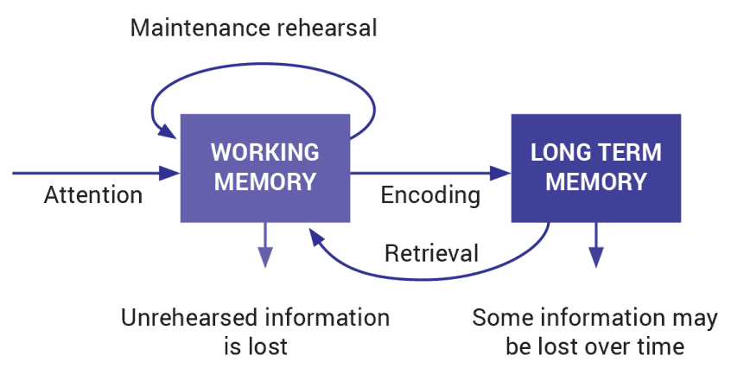
Information processing model
Working Memory:
  Limited capacity and duration.
  Processes novel information.
Long-Term Memory:
  Unlimited capacity.
  Stores organized information.
Cognitive load theory by Sweller in the 1980s - delineates the limited mental resources during learning (working memory).
https://theeducationhub.org.nz/an-introduction-to-cognitive-load-theory/

Slide 6
Cognitive load theory
Intrinsic load is mainly contributed by the inherent complexity of the information being processed.
  E.g. Complex concepts that involve involves understanding multiple interrelated elements exerts higher intrinsic load.
Extraneous load is imposed by the way information is presented and the tasks required by the instructional design.
  E.g. suboptimal presentation of information increases extraneous load for learning.
Germane load is the cognitive process that contribute to encoding information learnt into long-term memory.

Slide 7
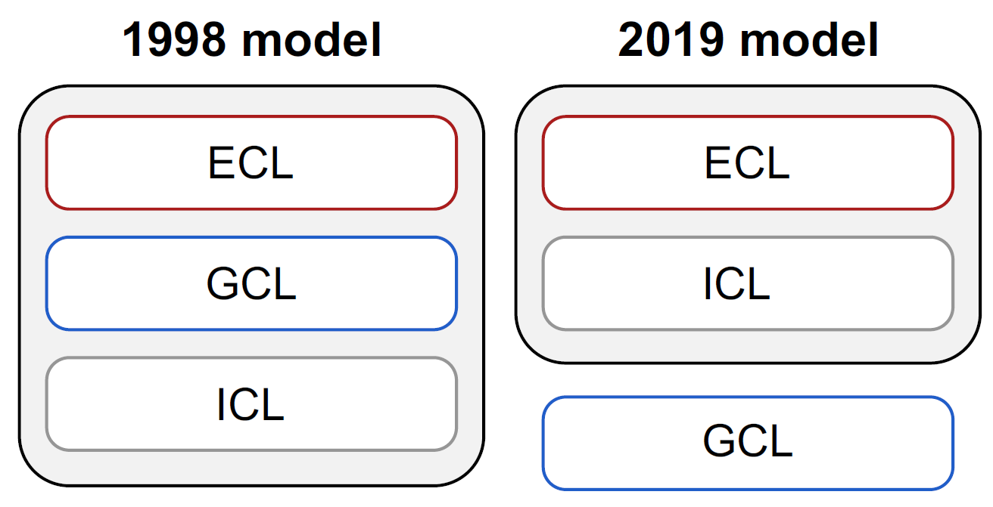
Cognitive load theory
Total cognitive load = intrinsic cognitive load + extraneous cognitive load
Since 2019, “germane load” is taken out of the additive equation of total cognitive load.

Slide 8
Menti word cloud

Slide 9
Intrinsic load - examples
Medical students diagnosing a patient with multiple symptoms and conditions with interacting pathophysiology, requiring integration of various disciplinary knowledge.
Learning how to use a new software to create presentation
  The interface and terminology are unfamiliar.
  Your brain has to work out the navigation - all while trying to create an actual presentation.
  Prior experience with the navigation → lower intrinsic load.

Slide 10
Chunking
Breaking lecture content into manageable chunks.
Grouping related information from a 1-hour lecture into several 10- to 15-minute chunks.
I chunked a 1-hour lecture on “Iron Metabolism and Heme Biosynthesis” into multiple 10-minute video clips:
  Part 1: Iron uptake
  Part 2: Regulation of iron metabolism
  Part 3: Heme biosynthesis and breakdown
  Part 4: Abnormalities in iron and heme metabolism

Slide 11
Extraneous load - examples
Note-taking
  The action of jotting down notes adds an additional task, requiring learners to divide their attention between listening and writing.
Lack of visual cues
  Visual aids help reduce extraneous load by providing a clear structure and context for the information.
  Without visual aids, learners may struggle to identify key points and organize their notes effectively.

Slide 12
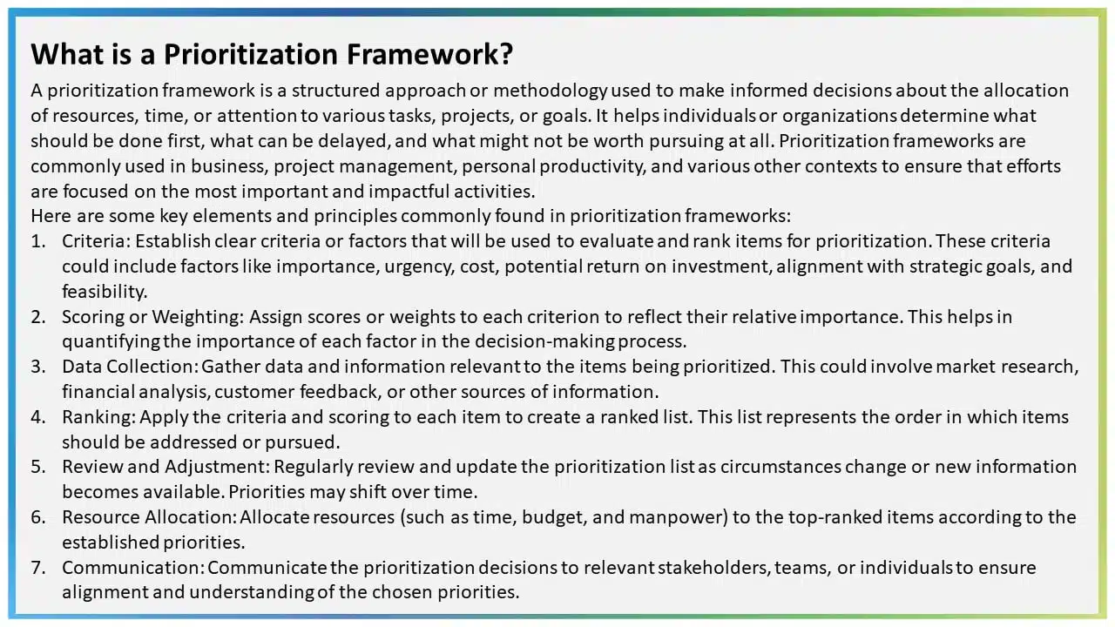
Example

Slide 13
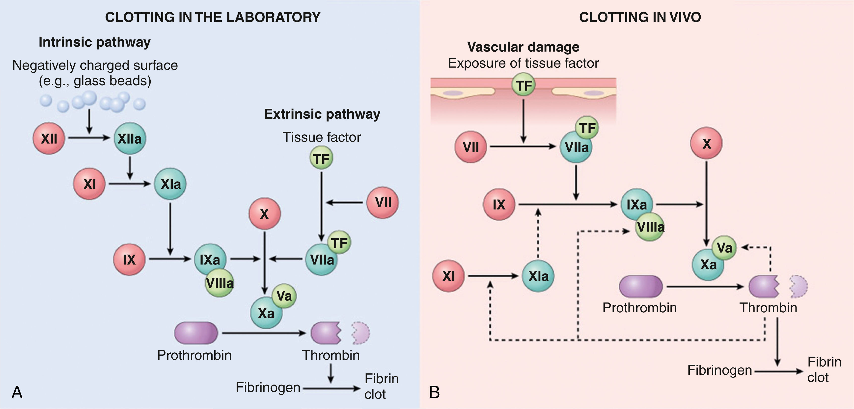
Coagulation cascade
EXAMPLE
Kumar et al. Robbins & Kumar Basic Pathology. 11e. Fig 3.7

Slide 14
Coagulation cascade
Coagulation cascade is different in in vitro and in vivo conditions.
Same aim: activate prothrombin into thrombin, which promote fibrin clot formation.
EXAMPLE
Kumar et al. Robbins & Kumar Basic Pathology. 11e. Fig 3.7

Slide 15
Coagulation in vitro
Coagulation is initiated by two pathways:
  Intrinsic pathway
  Extrinsic pathway
Calcium is essential for both pathways.
Intrinsic pathway is triggered by negatively charged substances such as glass beads.
→ activated thromboplastin time (aPTT)
Extrinsic pathway is triggered by addition of tissue factor.
→ prothrombin time (PT)
EXAMPLE
Kumar et al. Robbins & Kumar Basic Pathology. 11e. Fig 3.7

Slide 16
Coagulation in vitro: intrinsic pathway
Negatively charge surfaces cause the activation of Factor XII → Factor XIIa.
Factor XIIa then trigger a cascade of reactions: activation of factor XI and then factor IX.
Factor IXa complex with Factor VIIIa and activates factor X.
Factor Xa complex with factor V and activates prothrombin (inactive zymogen) into thrombin (active enzyme).
EXAMPLE
Kumar et al. Robbins & Kumar Basic Pathology. 11e. Fig 3.7

Slide 17
Coagulation in vitro: extrinsic pathway
Damaged blood vessel and tissue cells expose tissue factor.
  By definition, tissue factor originate from outside the blood, hence it is called “extrinsic pathway”.
Tissue factor complex with factor VII in plasma and activates factor X.
(Factor VIIa/factor Xa complex also activates factor IXa/factor VIIIa complex, which activates factor X)
Factor Xa complex with factor V and activates prothrombin into thrombin.
EXAMPLE
Kumar et al. Robbins & Kumar Basic Pathology. 11e. Fig 3.7

Slide 18
Coagulation in vivo
Tissue factor / factor VIIa complex activates factor IX.
Factor IXa / factor VIIIa complex is the main agent that activates factor X.
Factor Xa / factor Va complex activates prothrombin into thrombin.
Thrombin can activate factor XI, which activates factor IX to amplify the coagulation cascade.
  Factor XI deficiency only causes a mild bleeding disorder,
Factor XII are not very important for normal clotting, factor XII deficiency causes no bleeding disorder at all.
EXAMPLE
Kumar et al. Robbins & Kumar Basic Pathology. 11e. Fig 3.7
Notes:
n vivo, the factor VIIa/tissue factor complex is the most important activator of factor IX and the factor IXa/factor VIIIa complex is the most important activator of factor X (see Fig. 3.7B ). The mild bleeding tendency seen in patients with factor XI deficiency is likely explained by the ability of thrombin to activate factor XI, a feedback mechanism that amplifies the coagulation cascade.

Slide 19

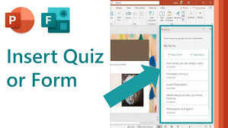

Audience response systems
ARS are tools that allow students to participate in lectures using devices like smartphones, tablets, or clickers.
  Mentimeter
  Kahoot
  Microsoft Form + Microsoft PowerPoint

Slide 20
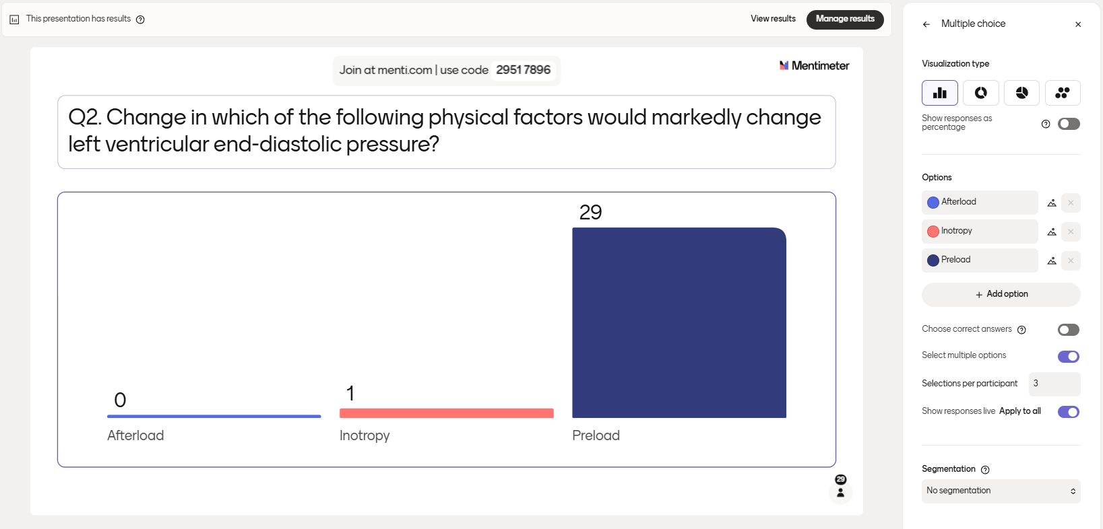
MCQ

Slide 21
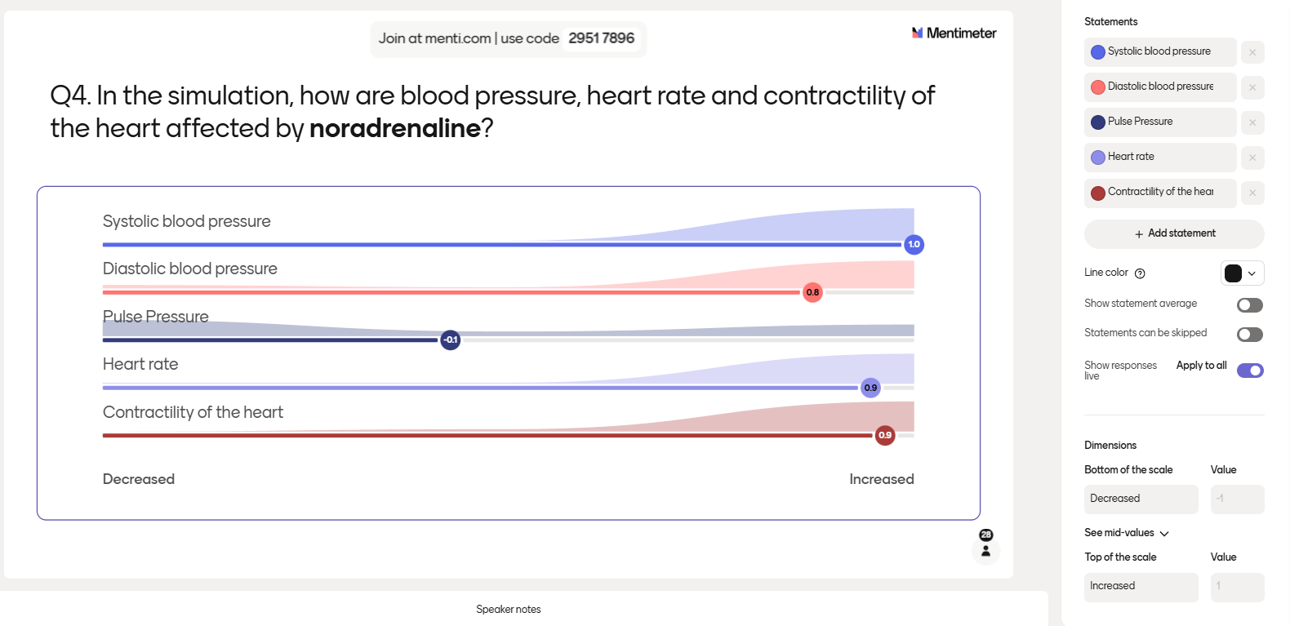
Scales

Slide 22
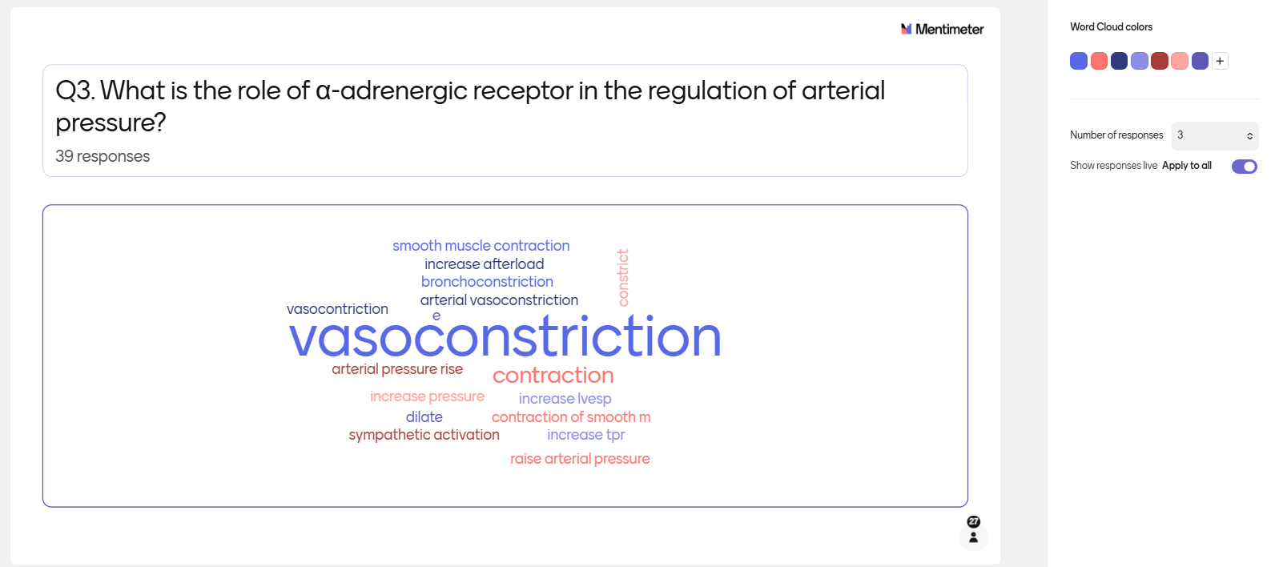
Word cloud

Slide 23

Audience response systems
Encourages students to engage directly with lecture material.
Real-Time Feedback: Students can vote, answer questions, and see instant results.
Inclusivity: Provides a voice to shy or introverted students who might not participate in traditional settings.

Slide 24
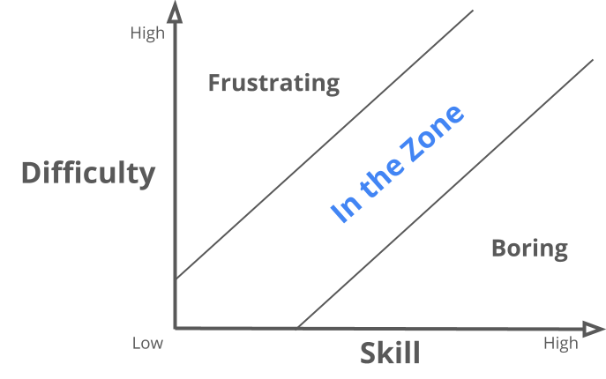
Key considerations
ARS can also contribute to increased cognitive load.
Unfamiliar interface and interactions promotes extraneous load.
Excessively long / complex questions increase both intrinsic and extraneous load.

Slide 25
Take-home message
Cognitive load is something that we should consider in designing a learning experience.
  Need to be mindful of intrinsic load and extraneous load
Cognitive load is NOT something to be fully eliminated.
  Zero cognitive load = boring to students
Interactivity enhances students engagement.
  too much interactivity may lead to fatigue
  too easy = boring; but too difficult = frustrating

Slide 26

Small-group exercise
We asked you to bring a set of your own lecture slides.
Applying what you learnt about cognitive load theory to consider
(i) how to enhance presentation
(ii) organisation of the content
Consider what type of interactivity you would introduce into your large-class teaching.

