Slide 1

eSFQ for
Subject: | [Sub code Sub name] e.g. POLYU1001 Academic Integrity
Staff member: | [Staff name] e.g. Dr James Smiley
Part(s) of teaching: | [Lecture, Tutorial, Lab., etc.] e.g. Lecture & Tutorial
Notes:
Provide the appropriate information on the eSFQ to be conducted.

Slide 2

Purpose of eSFQ
To collect student feedback regularly for improving and assuring the teaching and learning quality at PolyU
  PolyU uses eSFQ results to appraise teaching quality of staff, programmes and departments
Note: Your feedback is anonymous to your teachers and will not affect your grades. Your feedback will be available to your teachers only after the exam results are finalised.

Slide 3
How to do the eSFQ?
You will need to use a mobile device or a laptop
If you don’t have one with you now, please complete the eSFQ as soon as you have access to a mobile device or a computer
Spare 5-10 minutes to complete each eSFQ form

Slide 4
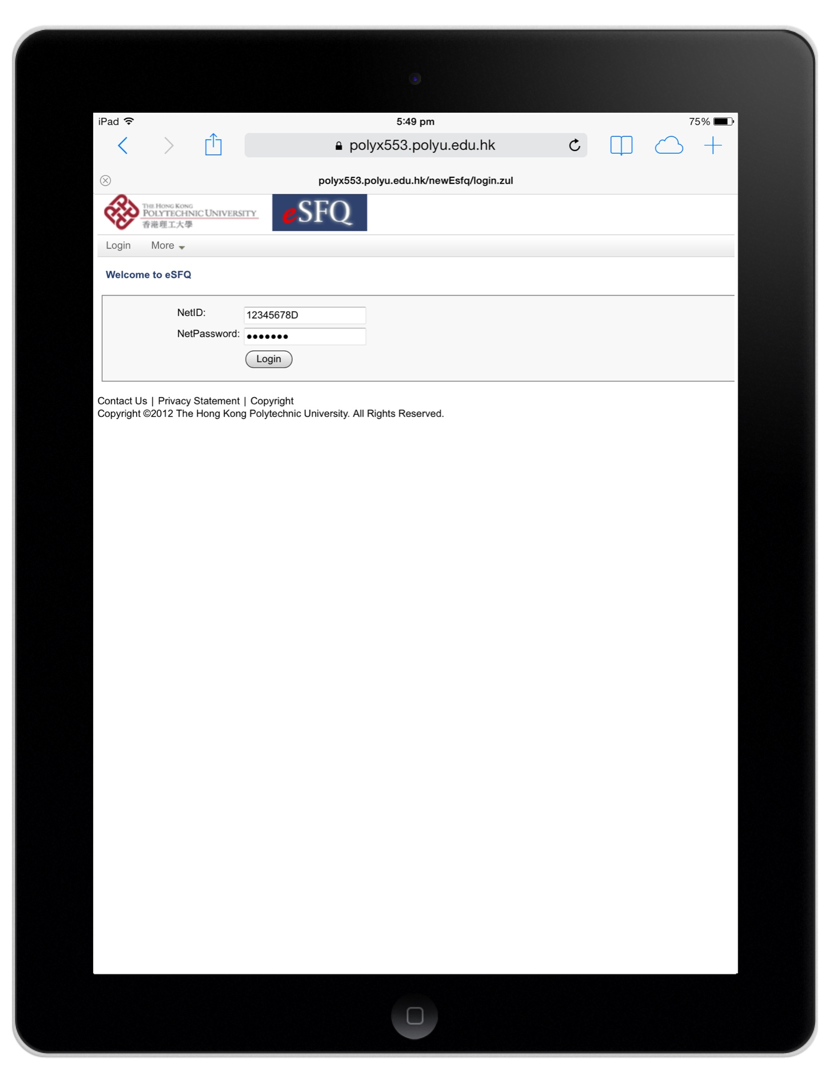
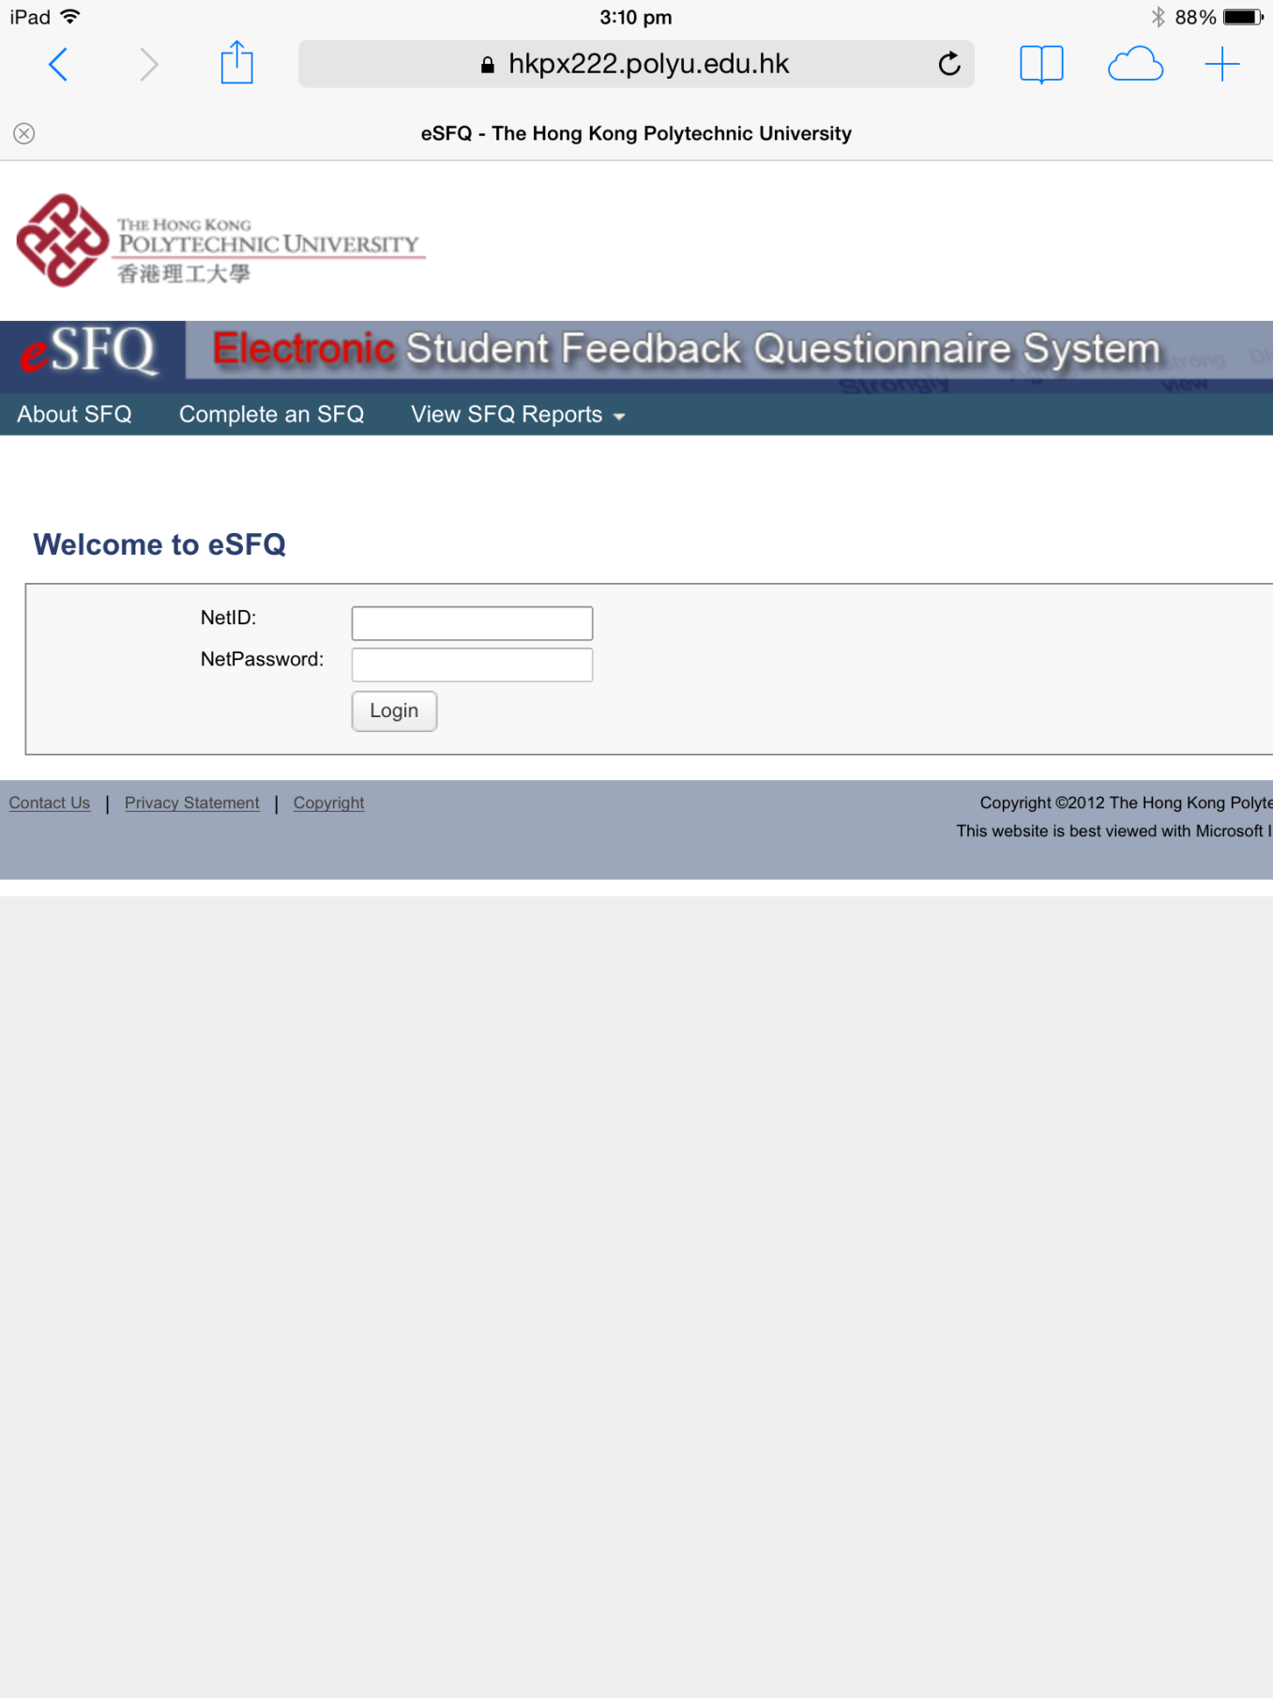
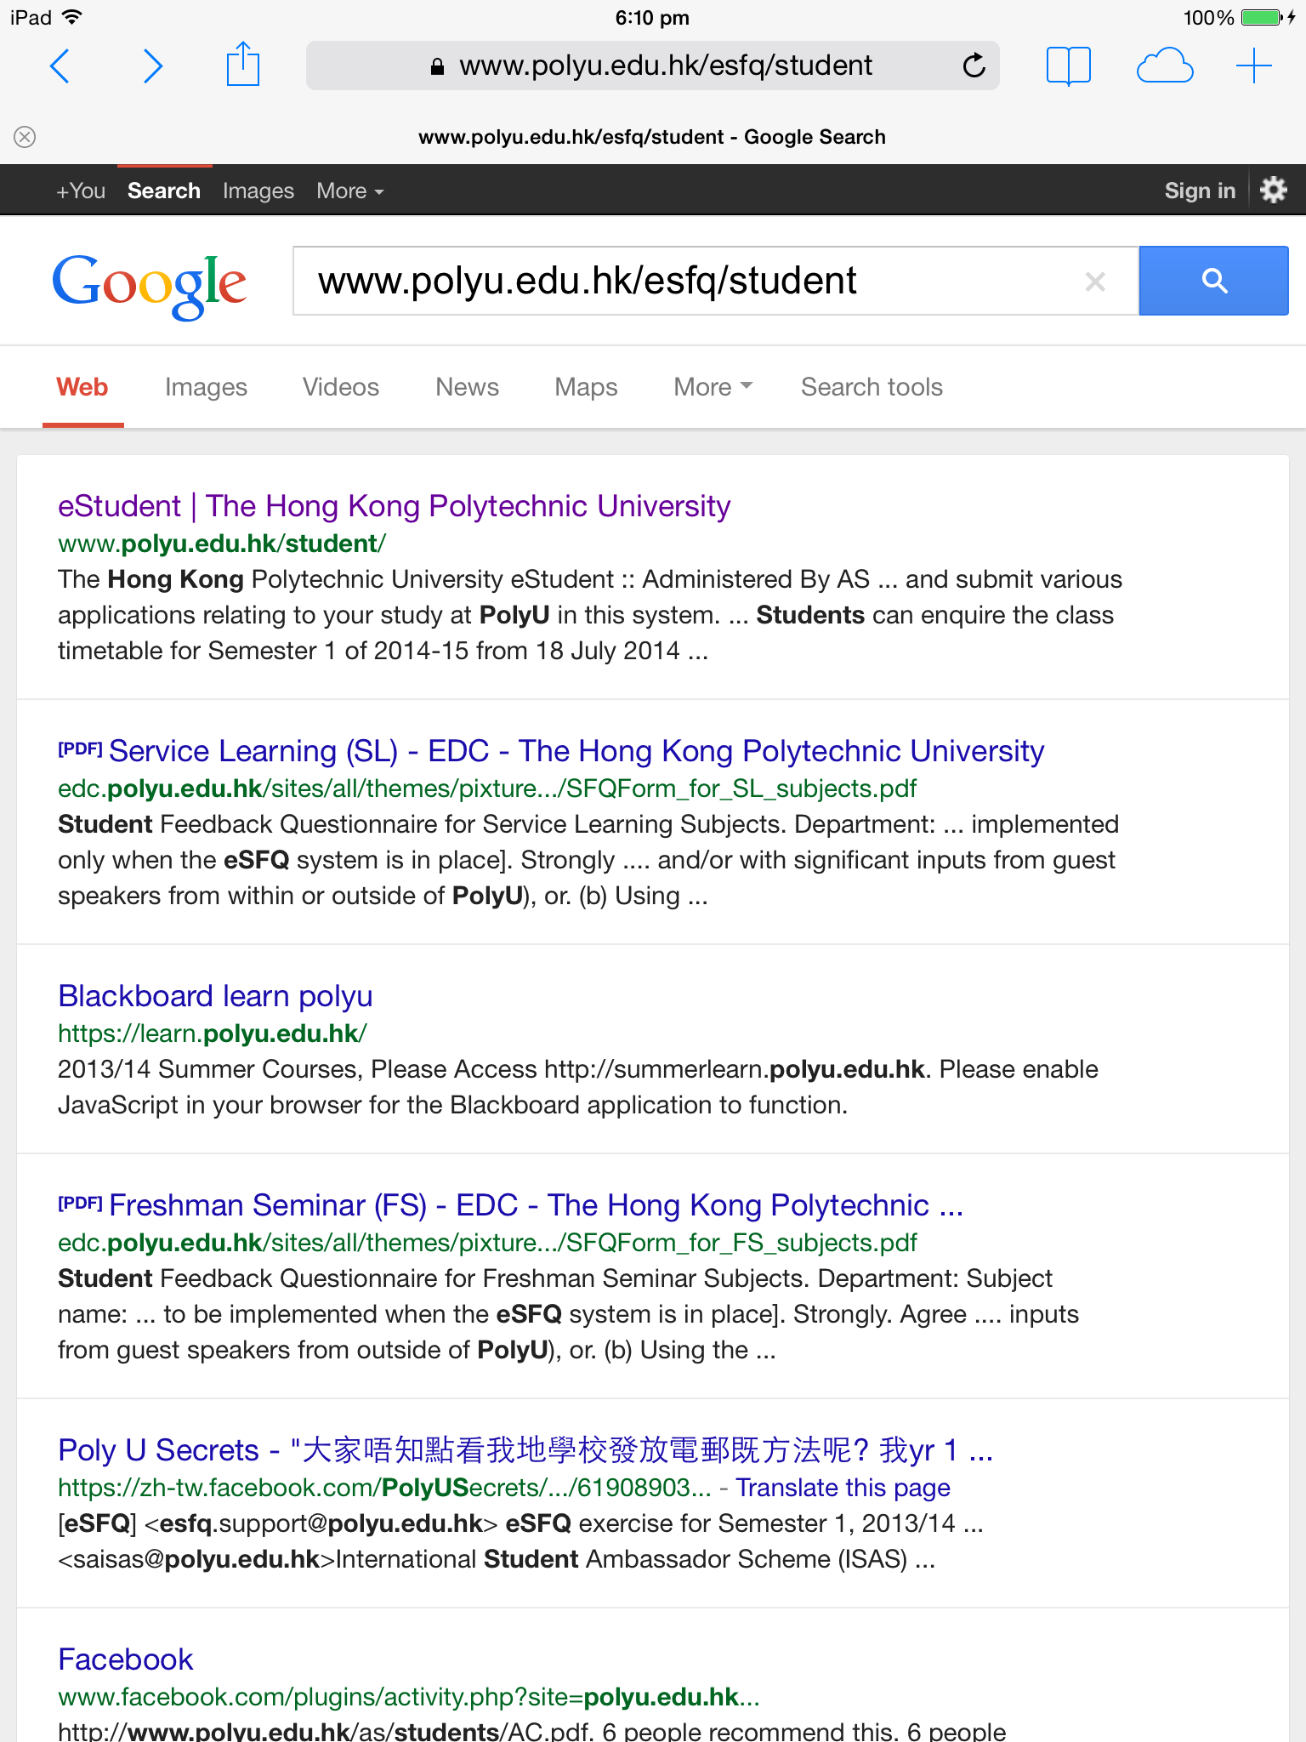
Step 1
Using your mobile device or laptop, go to: www.polyu.edu.hk/esfq/student ; then log in using your Net ID and Net Password.

Slide 5
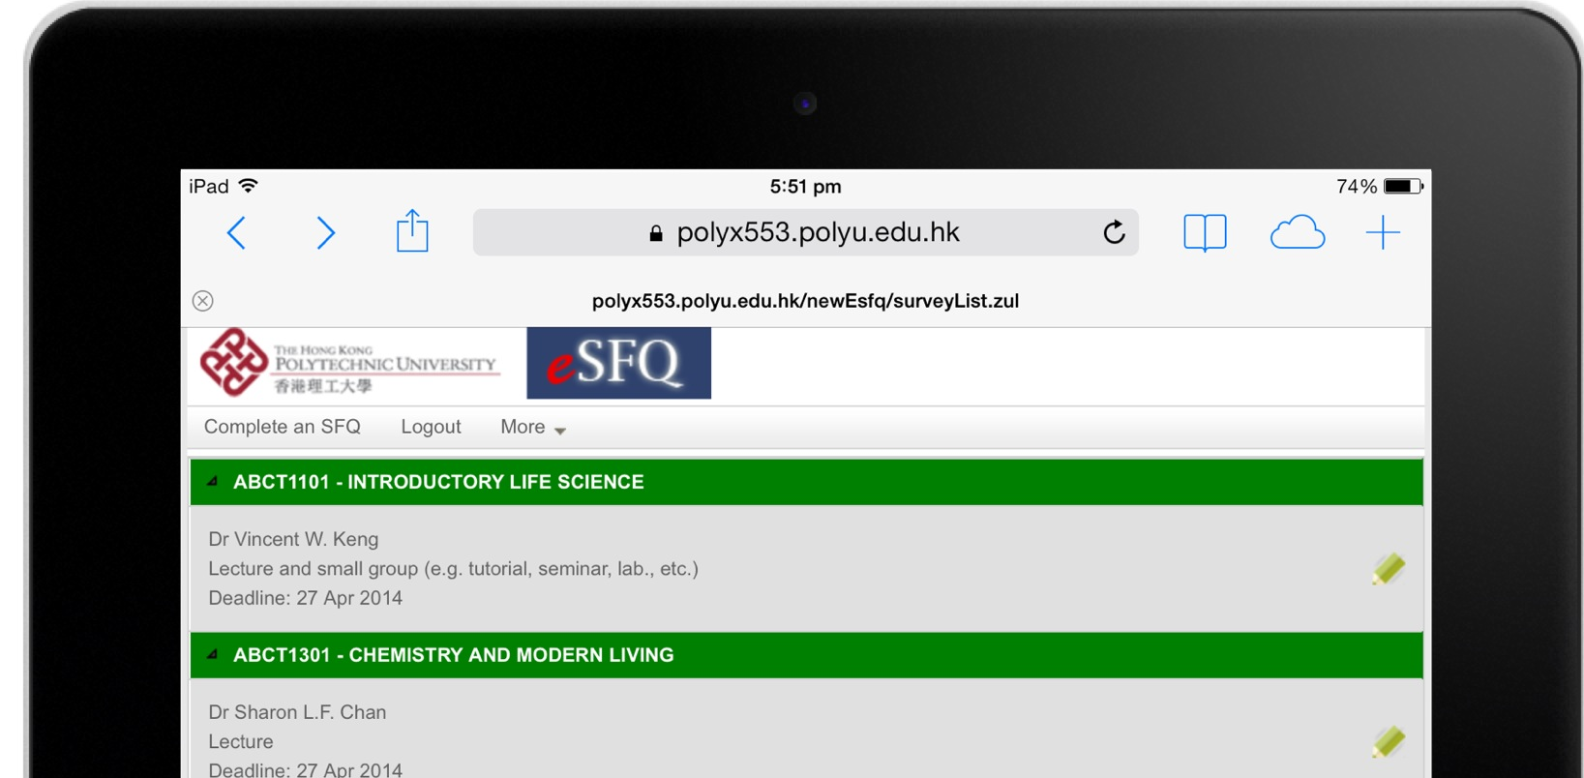
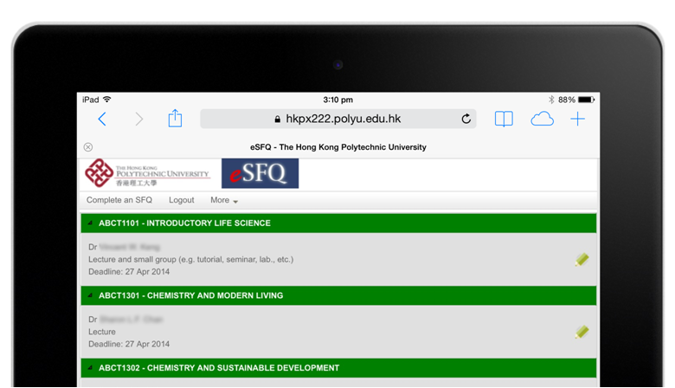
Step 2
Tap on the appropriate eSFQ form for this subject/the teaching staff.

Slide 6
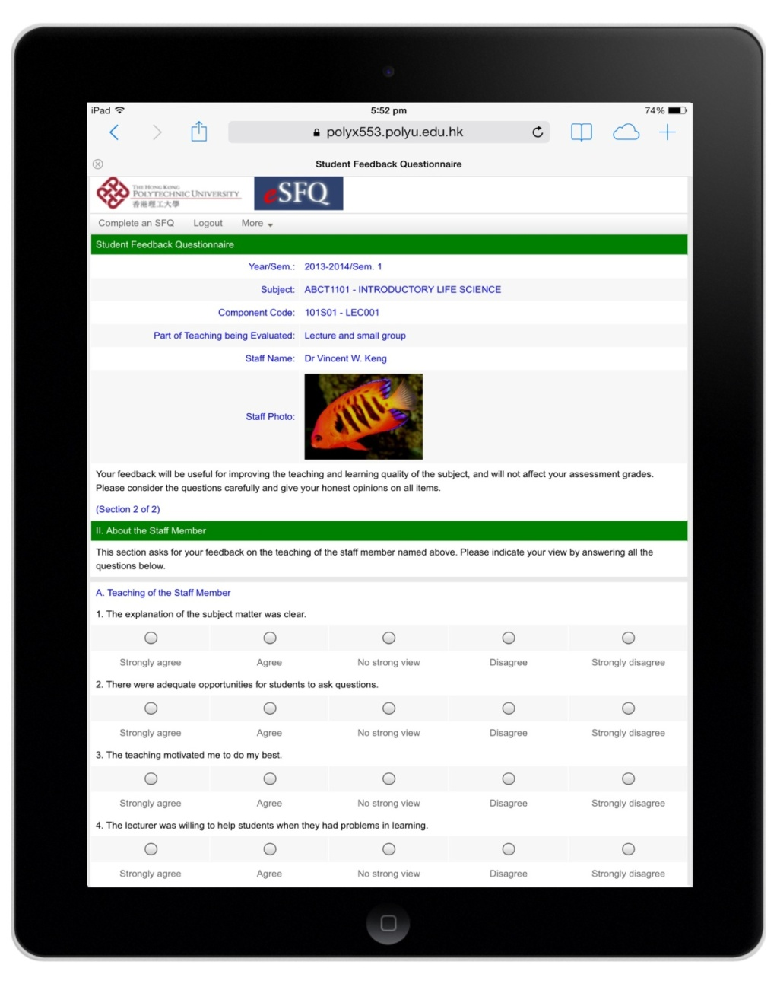
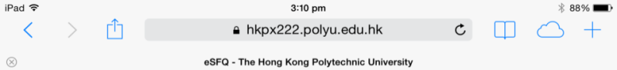

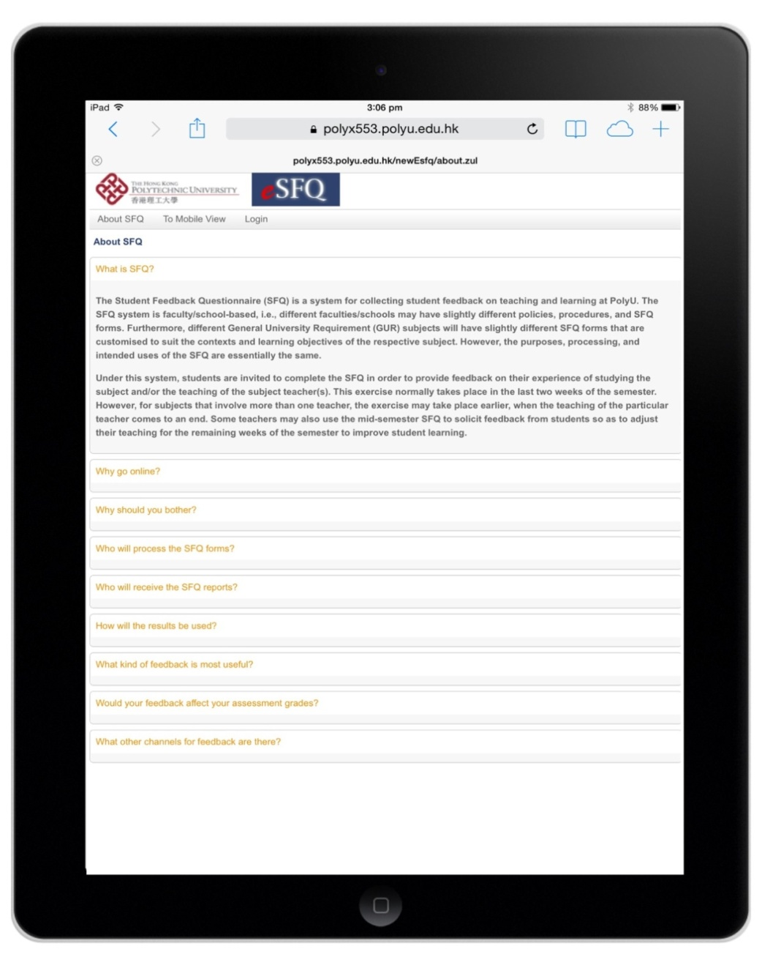

Step 3
Complete the eSFQ form.
If you are not in the mobile view, tap “To mobile view” on the top menu bar.

Slide 7
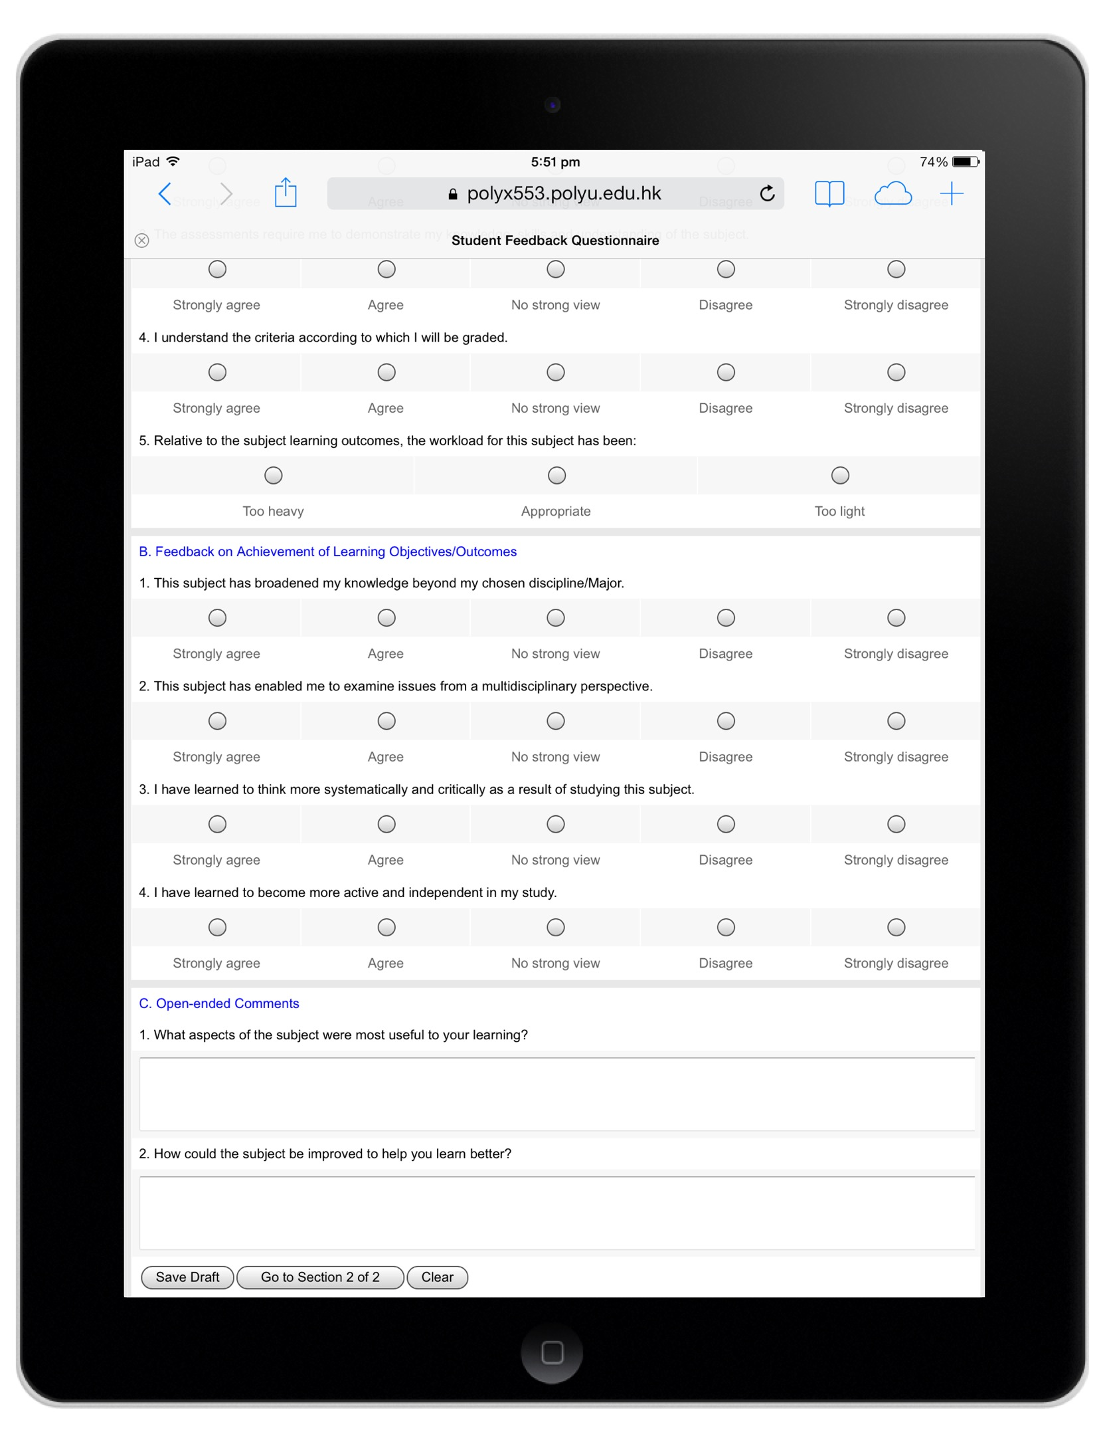
Step 4
To save your responses, tap the “Save Draft” button
To go Section 2, tap the “Go to Section 2” button (if applicable)
To clear the form, tap the “Clear” button

Slide 8
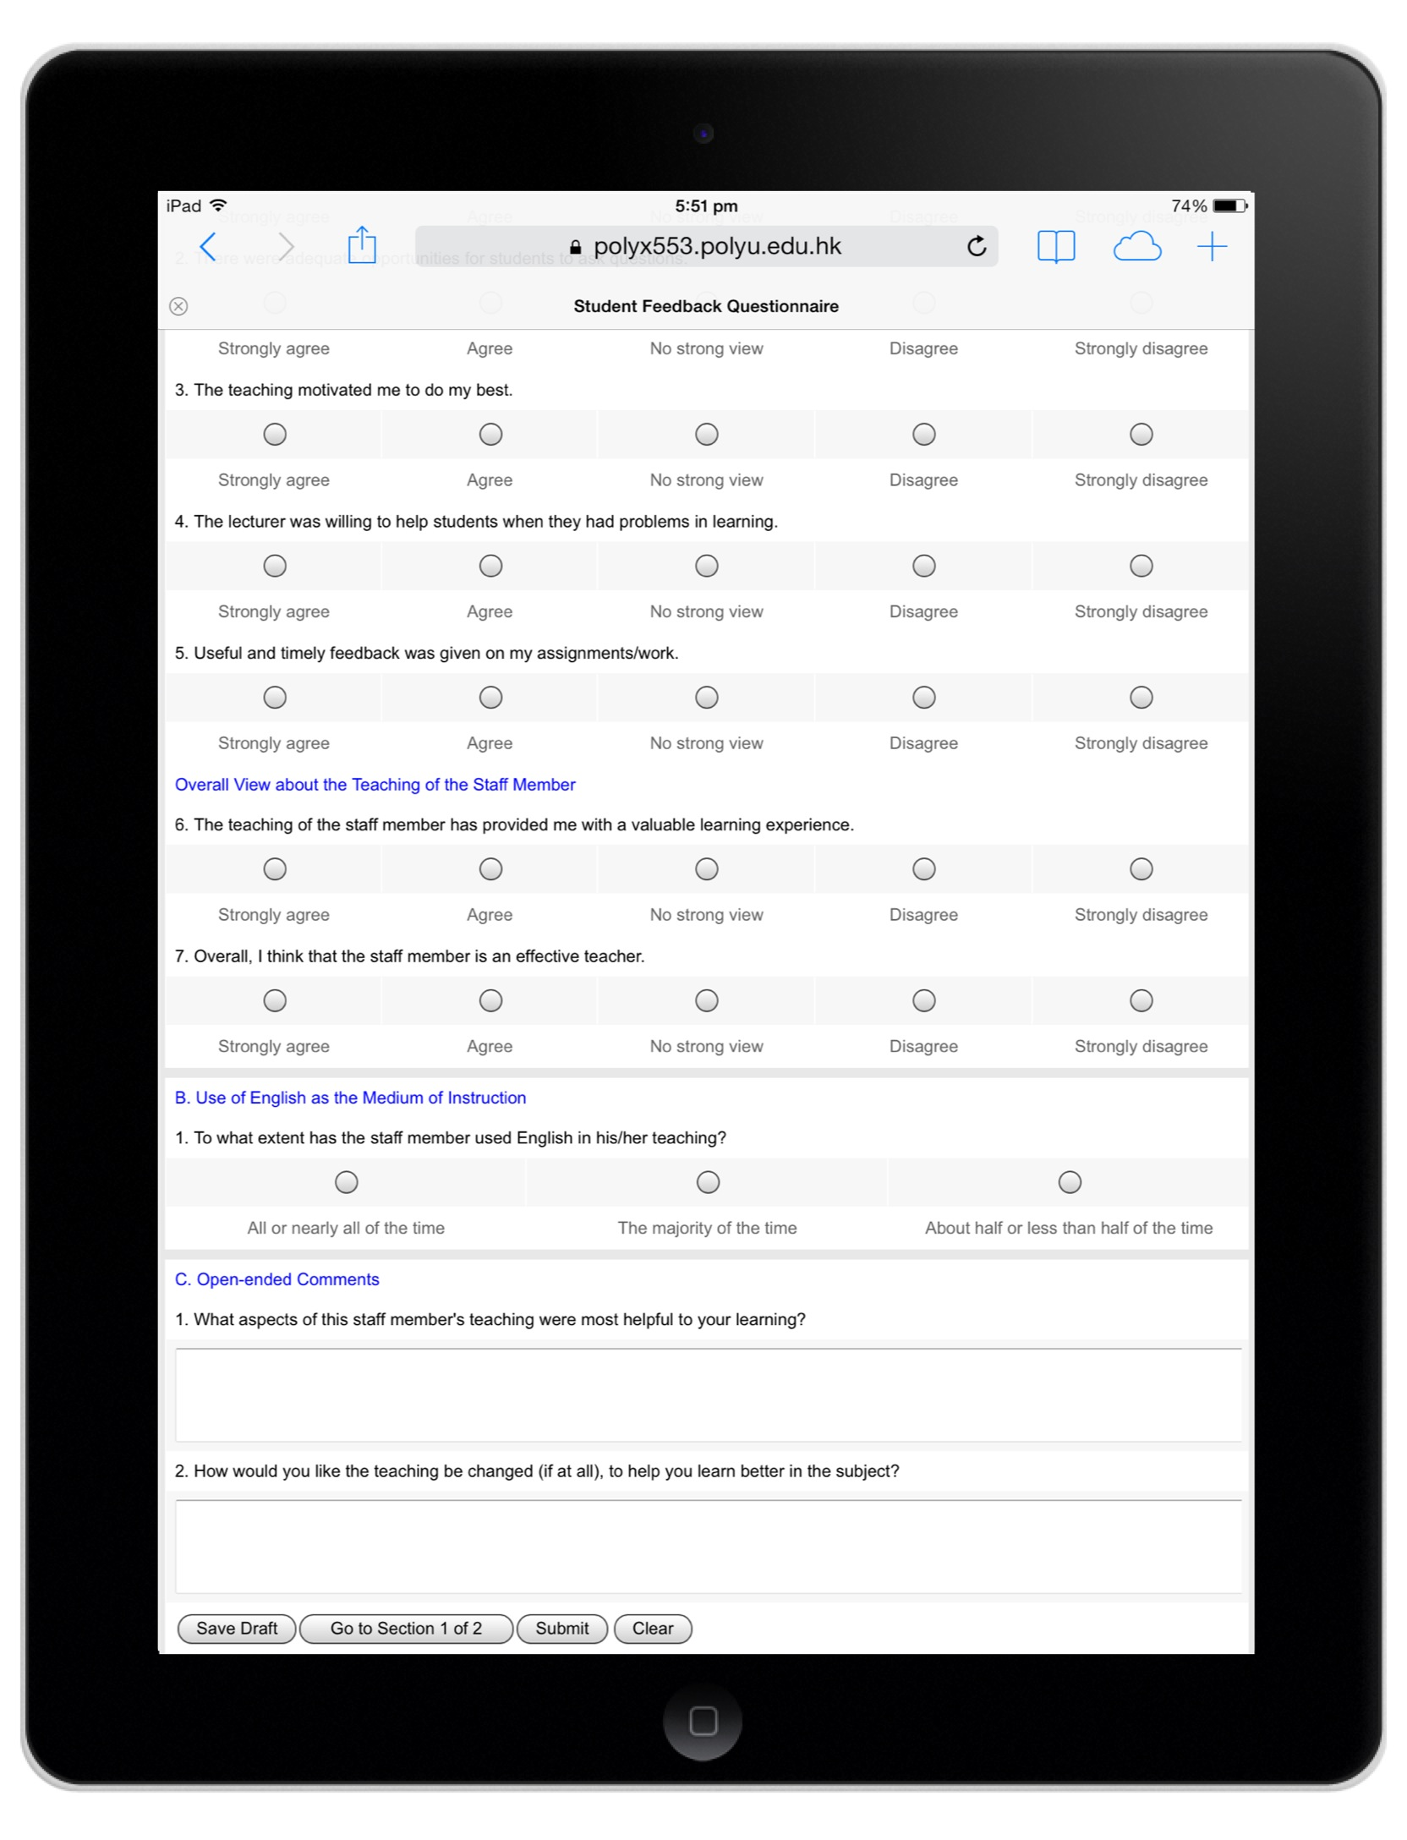
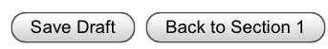
Step 5
When you have completed the form, tap the “Submit” button to submit it.
Note: You can submit the form only once.

Slide 9
Please complete the eSFQ now at www.polyu.edu.hk/esfq/student
Please provide thoughtful feedback as it helps improve teaching and learning.
5 min
10 min
15 min
20 min
Stop Timer
Start Timer
Notes:
Click “Start Timer” once to start the timer.
To restart timer, hit the left arrow key (←) on the keyboard; alternatively, right click on the slide then choose “Previous”.
When it reaches the desired amount of time, click “Stop Timer” once.
Note:
Please allow sufficient time for students to do the eSFQ if more than one form is to be completed for the same subject/class.
You can use a mobile device to check the response rate via the eSFQ system (www.polyu.edu.hk/esfqadmin) if you wish to do so.

Slide 10
Thank you very much for providing us with your valuable feedback
If you still haven’t finished completing the eSFQ, please save your draft now and complete it later.
If you don’t have a mobile device, please remember to complete your eSFQ when you have access to a mobile device or a computer.

