Slide 1
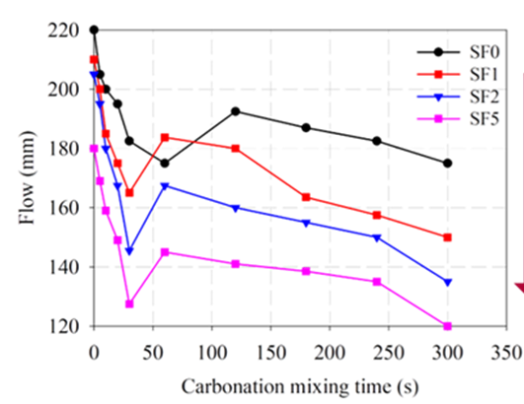
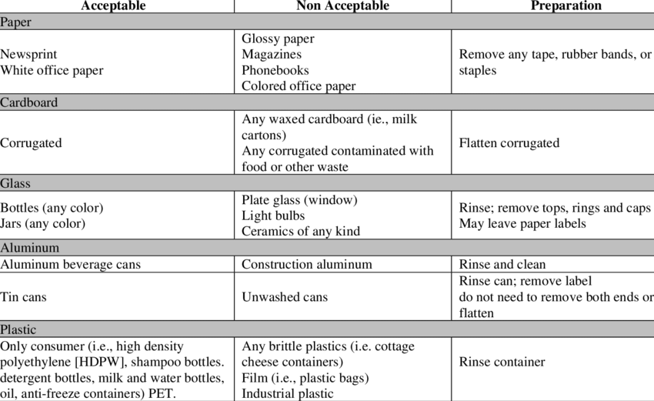
Paper Title Can Be Two-Line Long
Title Continued
Author 1 Firstname Lastname¹, Author 2 Firstname Lastname², Author 3 Firstname Lastname³ (Underline presenting author’s name)
Dept., Institution Name¹, Dept., Institution Name², Dept., Institution Name³
INTRODUCTION
Provide briefly background information
Outline research questions, hypotheses, and gaps
State the objectives of the research
Etc.
METHODOLOGY
Provide your research method
Present only key equations
Use diagrams and photos for effective communication
Etc.
RESULTS & DISCUSSION
Present the findings in logical order of importance
Use figures and tables whenever possible with captions and suitable font size
Discuss the results
Highlight the insightful findings
Discuss limitations of your research
CONCLUSIONS
Give major findings from your research
Make recommendations on future research direction
ACKNOWLEDGEMENTS
List the acknowledgements

