Slide 1
Correct location of throwing rubbish
AP
Feb,2021

Slide 2
Objective
This PowerPoint guided you that where is the correct location for wooden package and large rubbish.
The Garbage station is located near Y Block, P podium
Trolley can lend from Pai, Henrietta or Lam Two

Slide 3
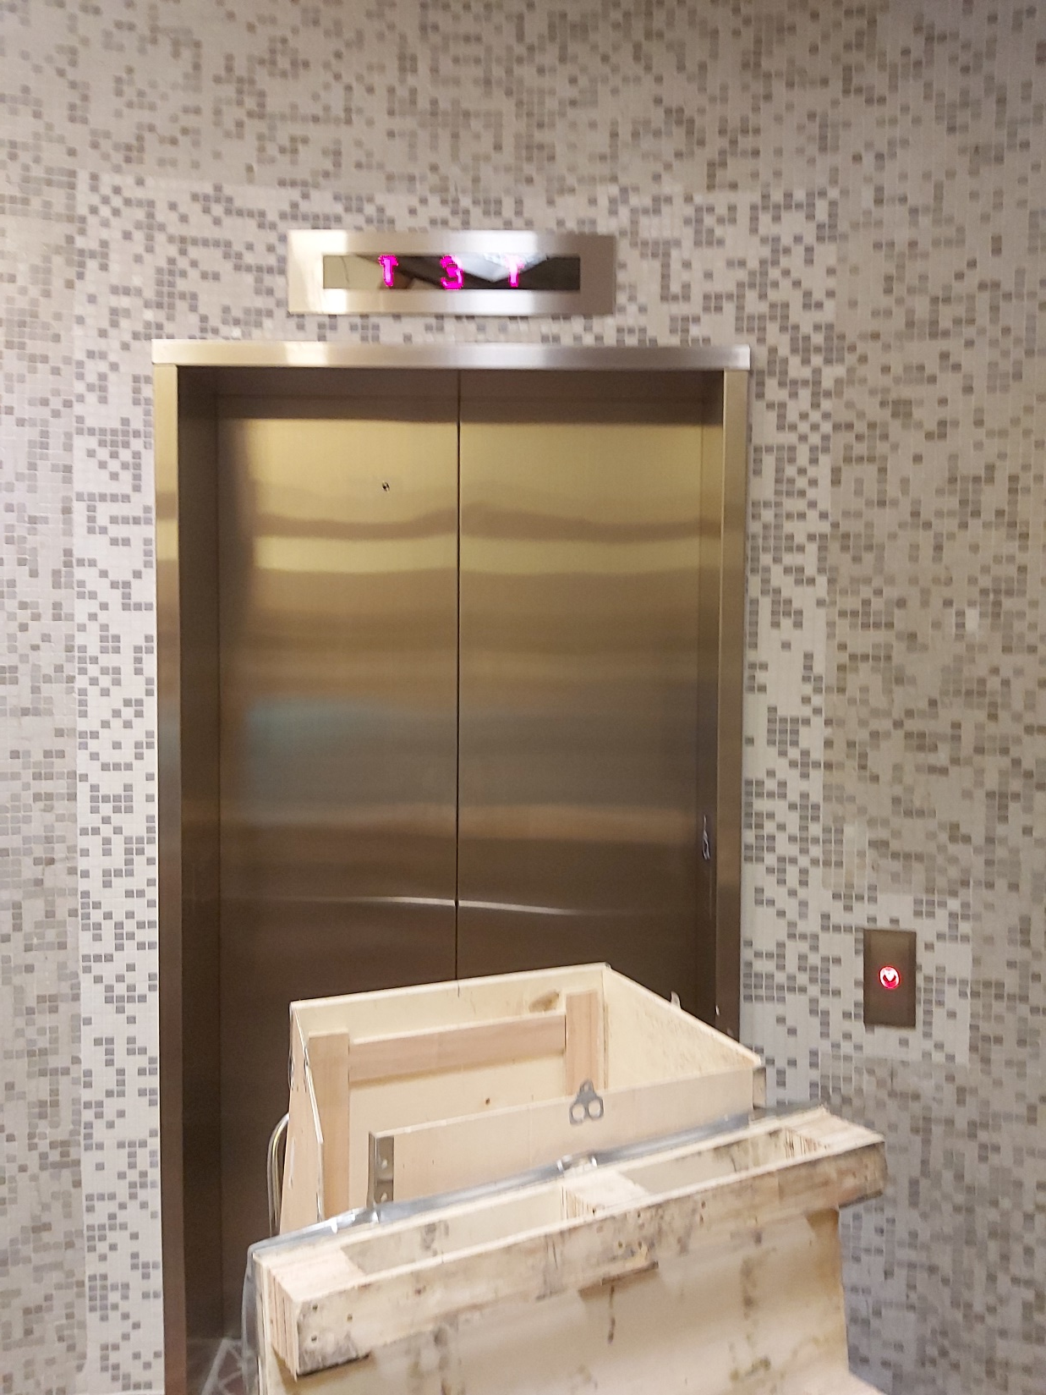
Go to core F

Slide 4
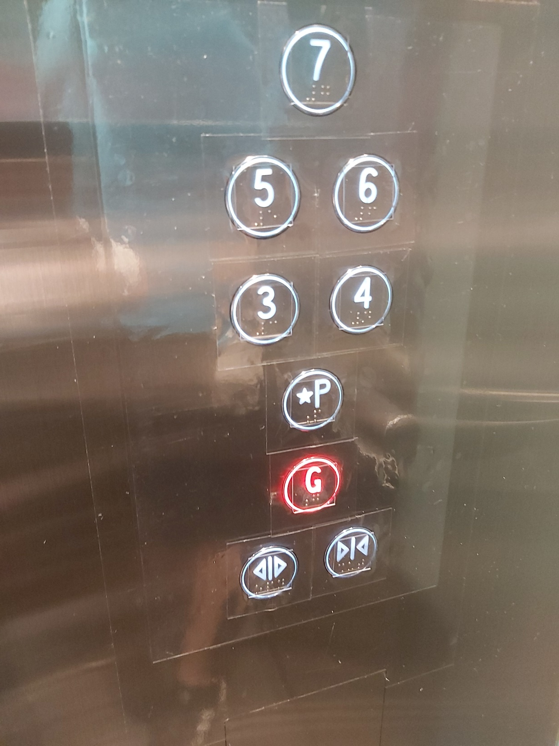
Go down to the ground floor

Slide 5
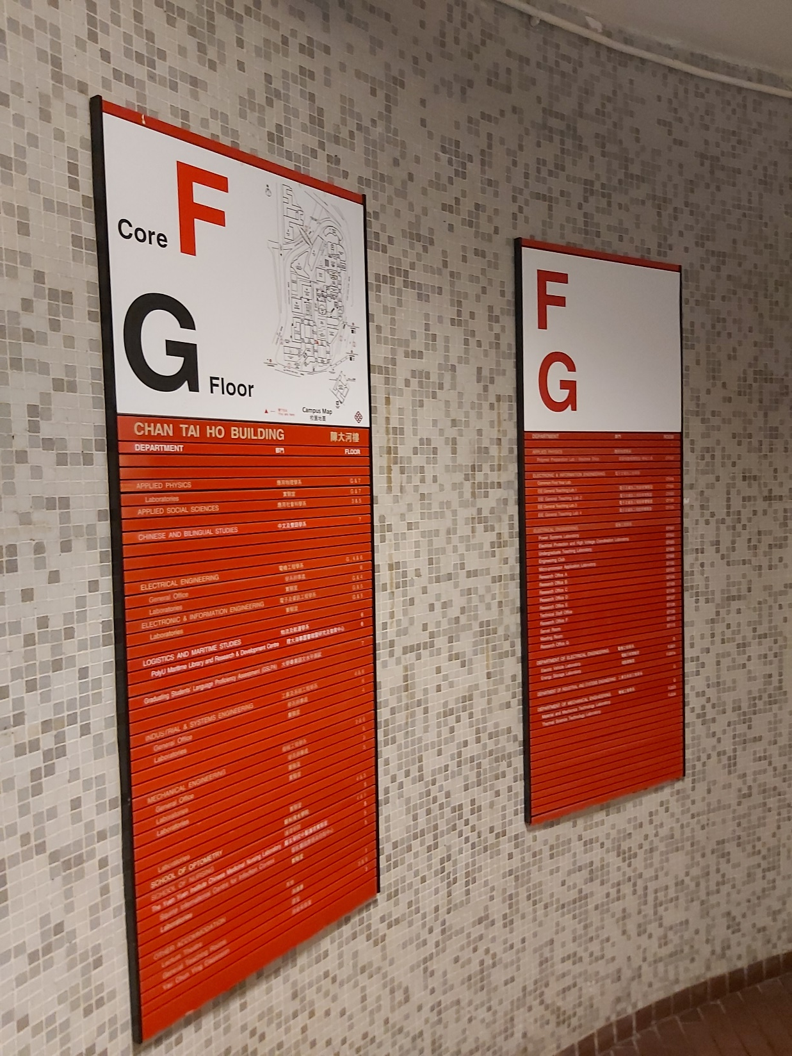
Exit the elevator

Slide 6
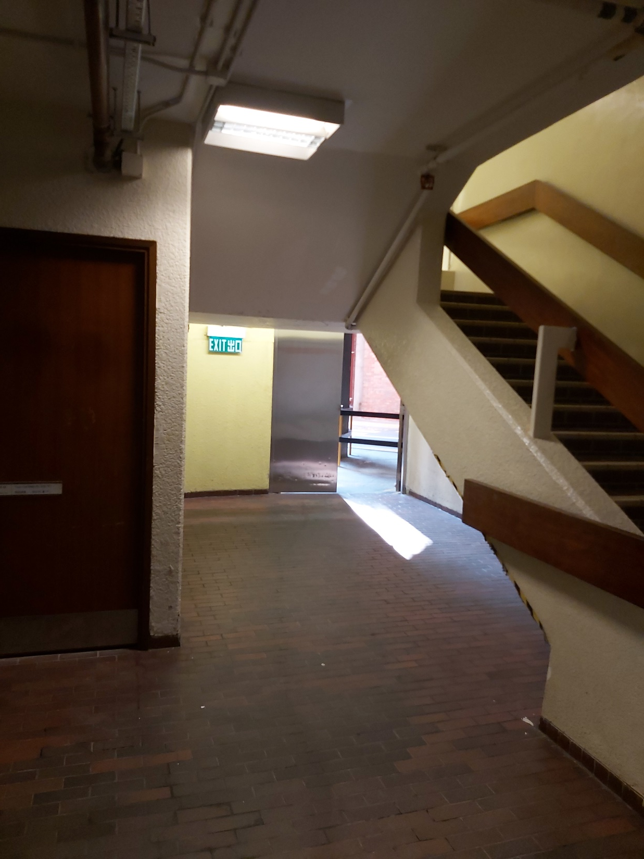
Go to the exit and right turn

Slide 7
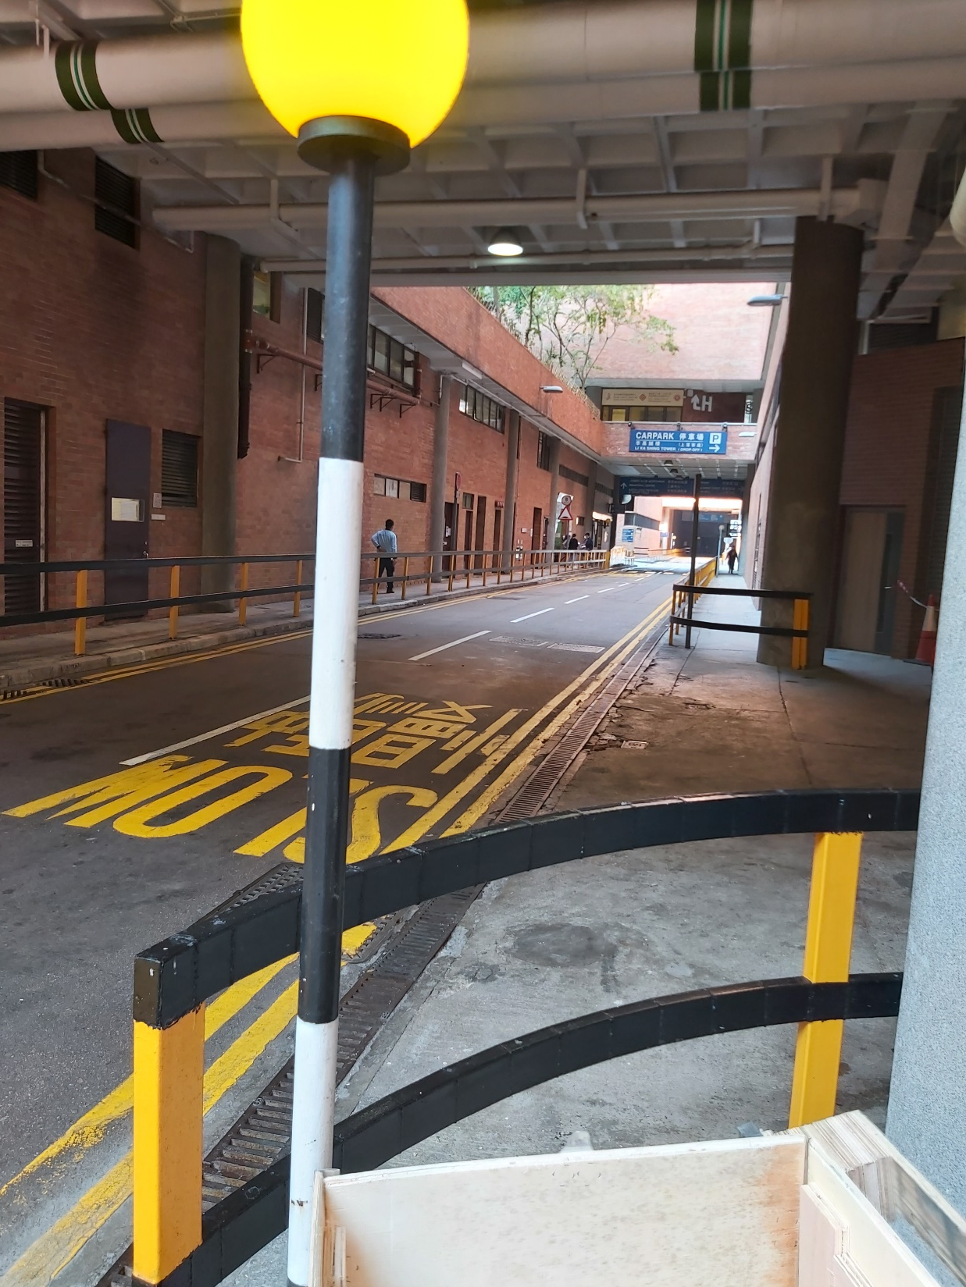
Go straight ahead

Slide 8
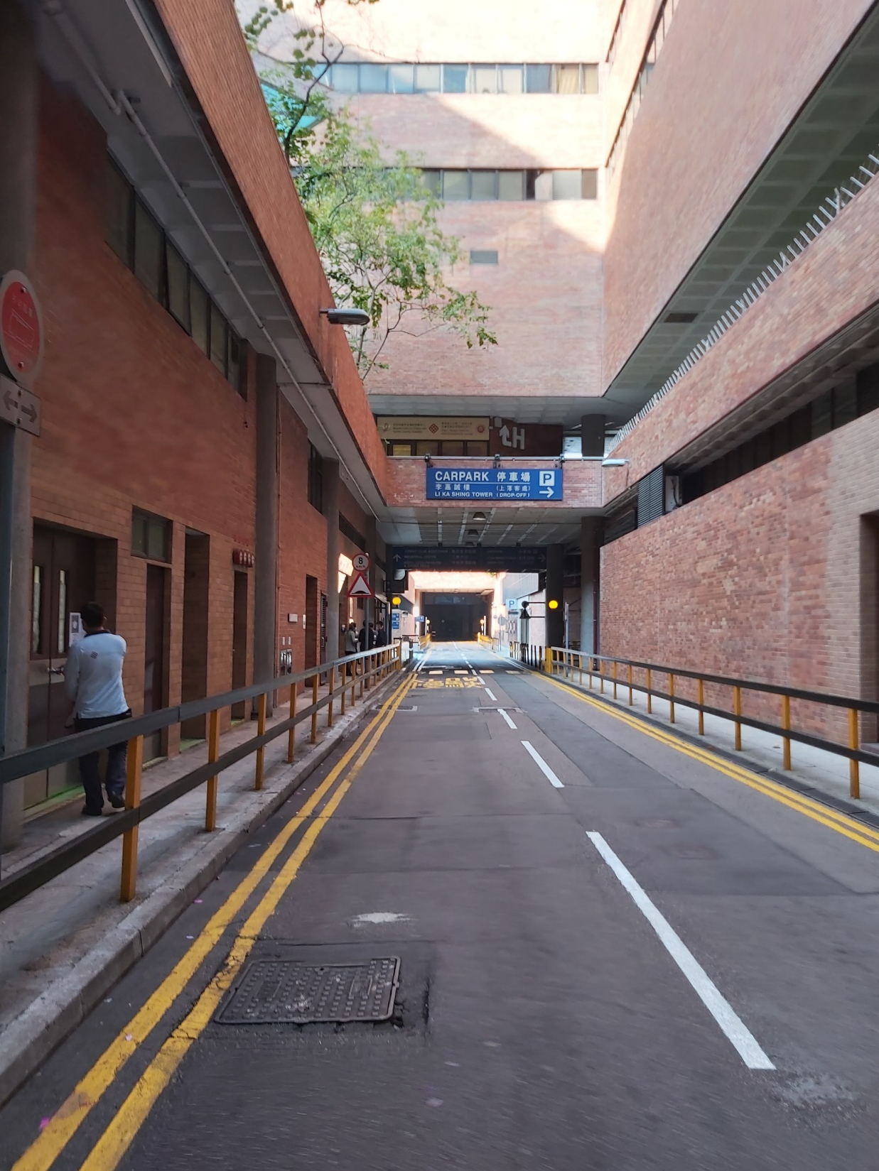
Go straight ahead

Slide 9
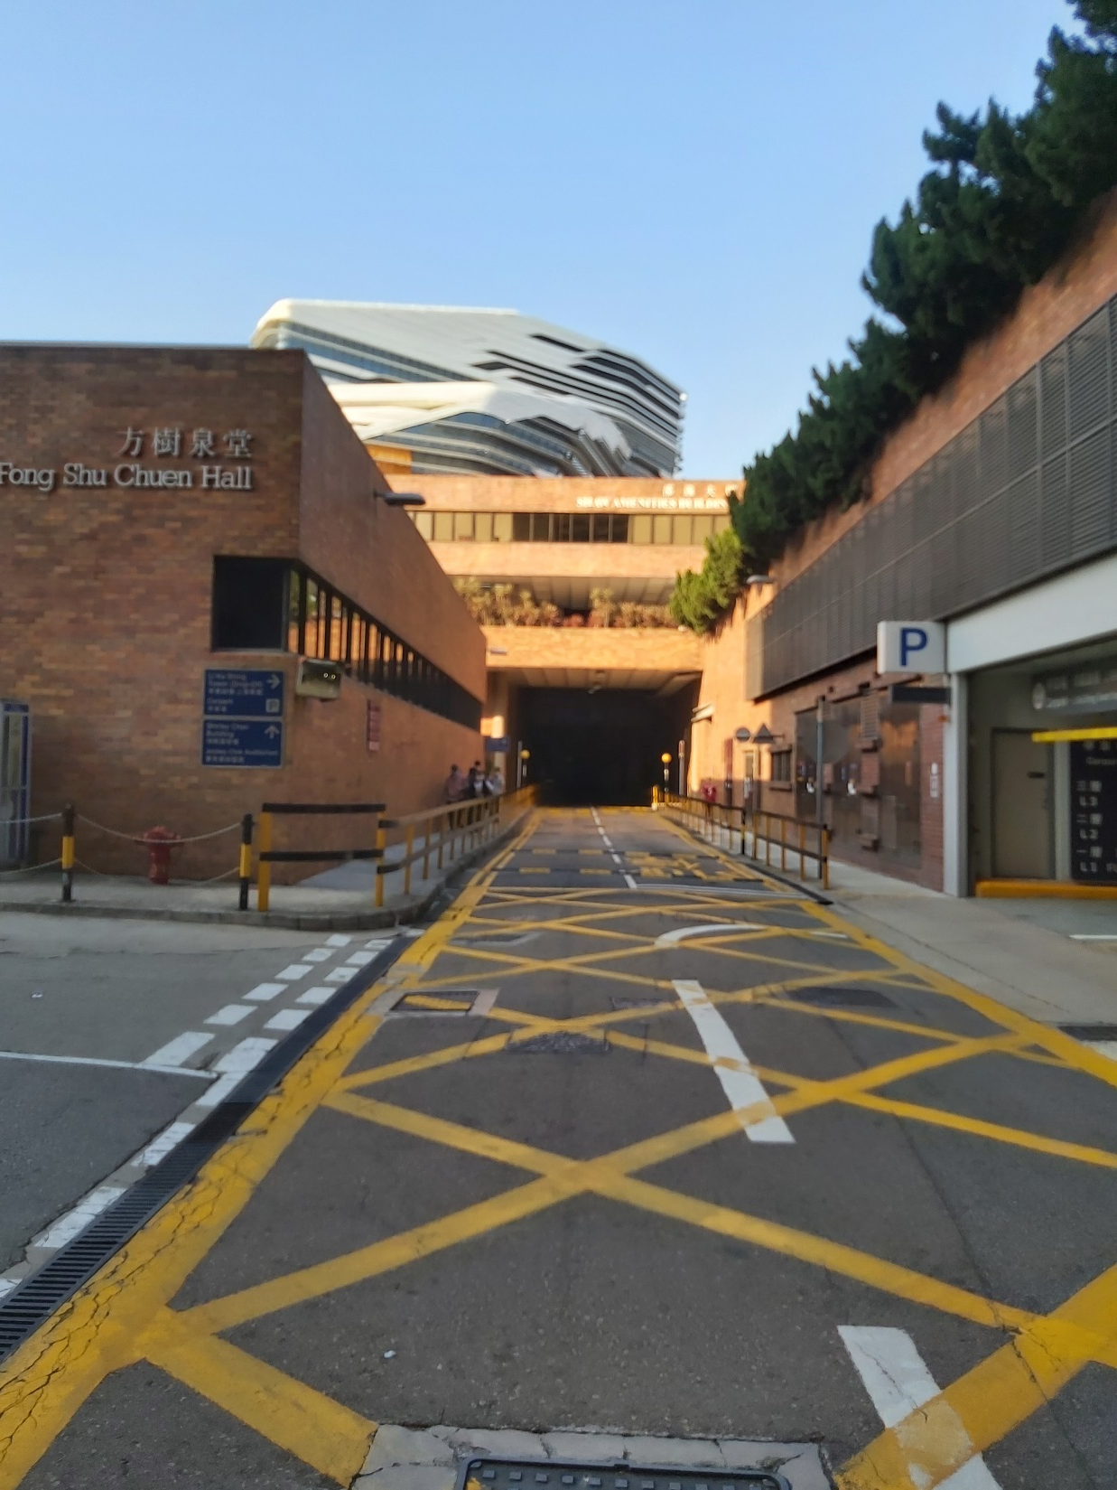
Go straight

Slide 10
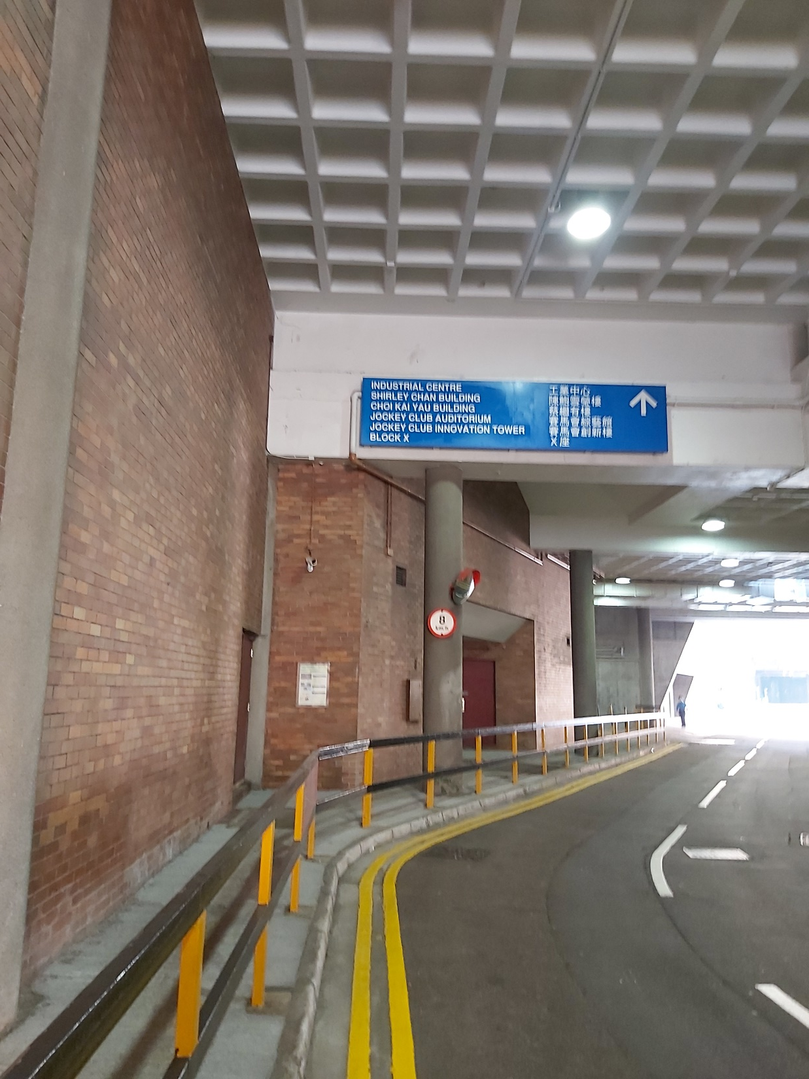
Go straight ahead

Slide 11
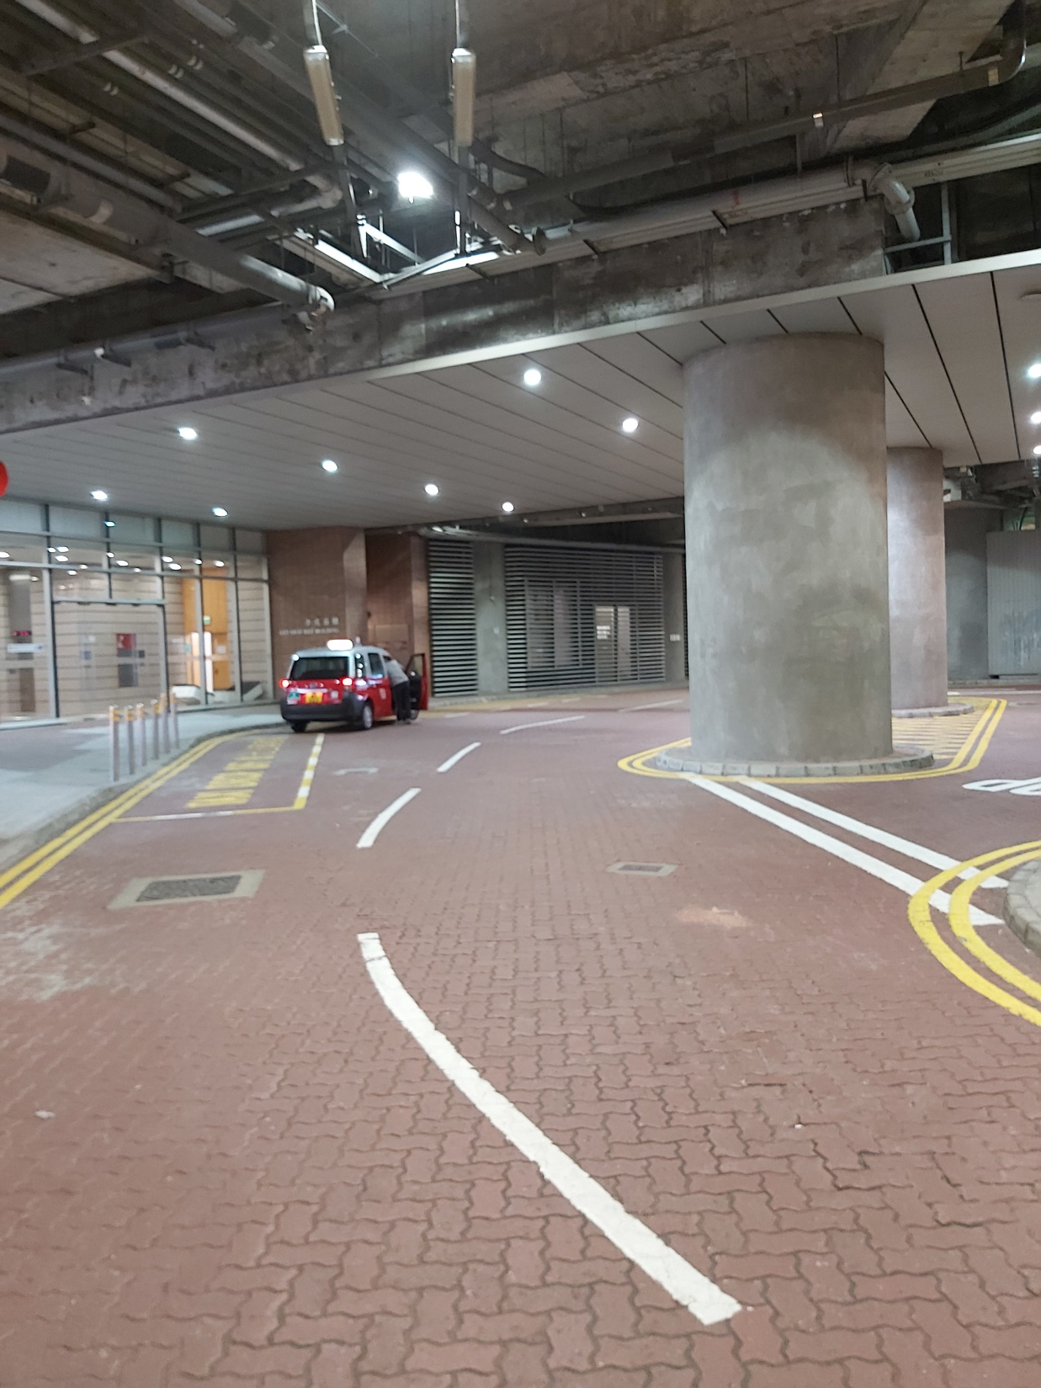
Go straight ahead

Slide 12
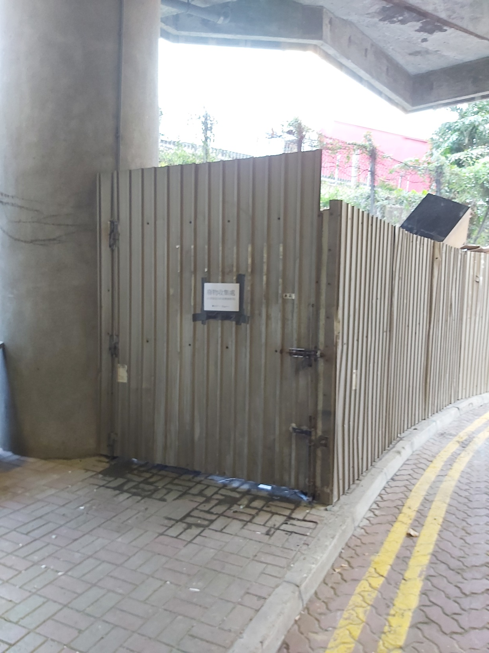

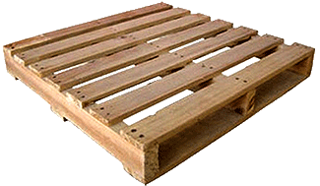
Near Y core, P podium
Put the rubbish inside this room

