Slide 1
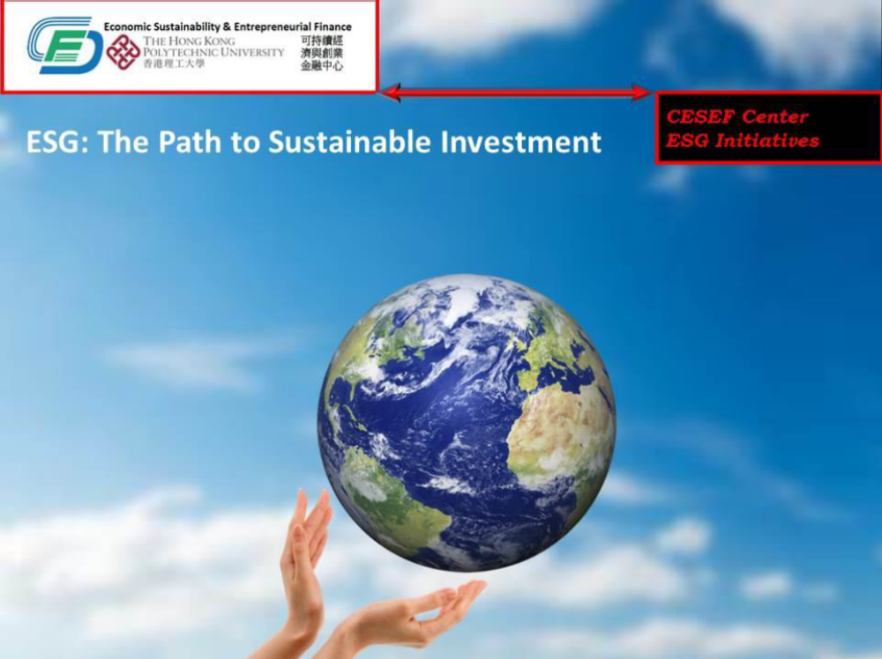
Professor Louis Cheng
Center for Economic Sustainability &
Entrepreneurial Finance (CESEF)
The Hong Kong Polytechnic University
MLA x Sustainability
Curriculum Design

Slide 2

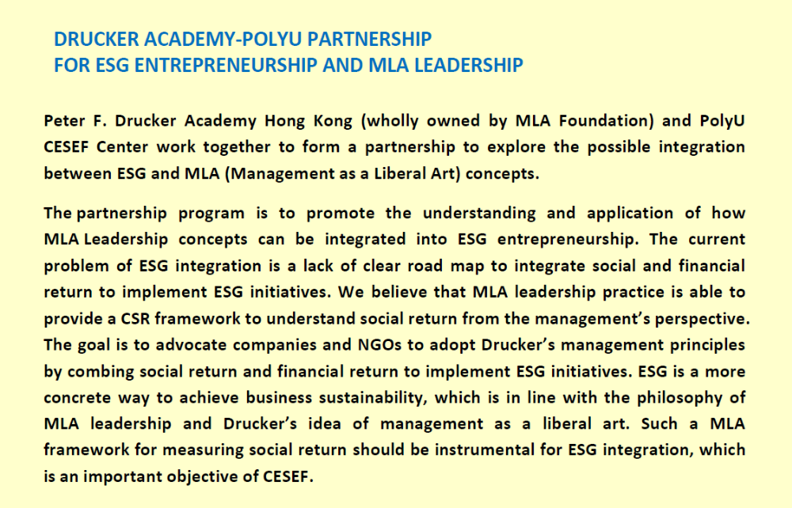

Slide 3
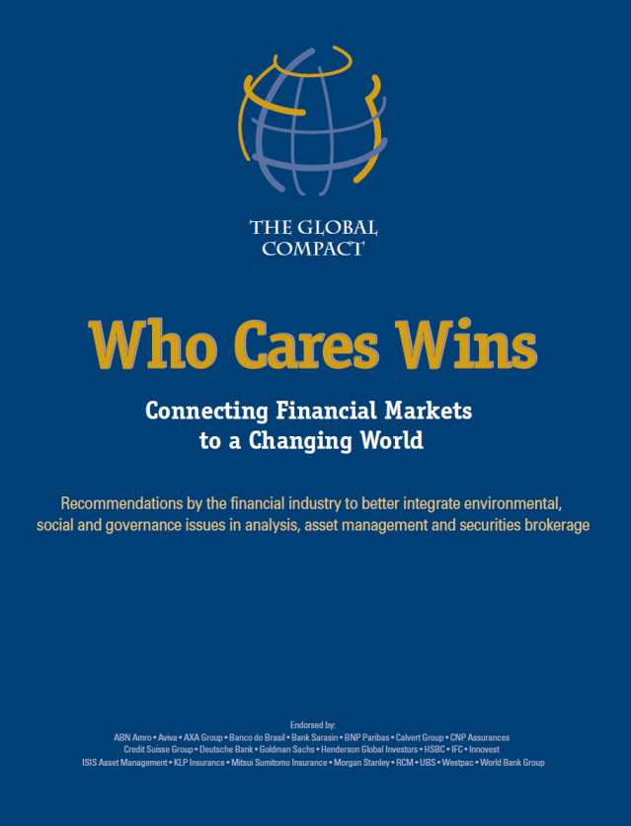
What is ESG?
The term “ESG” stands for Environmental, Social and Governance. ESG can be defined as an evaluation framework which prescribes a set of E, S, and G factors in the investment decision-making process to evaluate companies and institutions for the purpose of “sustainable investing”.
The idea of ESG was first formally developed in December 2004 when the U.N. Global Compact produced a report entitled Who Cares Wins.
The report argues that the financial industry should integrate ESG aspects in asset management, securities brokerage services and the buy-side/sell-side research.
Such ESG integration can lead to more resilient investment markets and contribute to the sustainable development of societies.

Slide 4
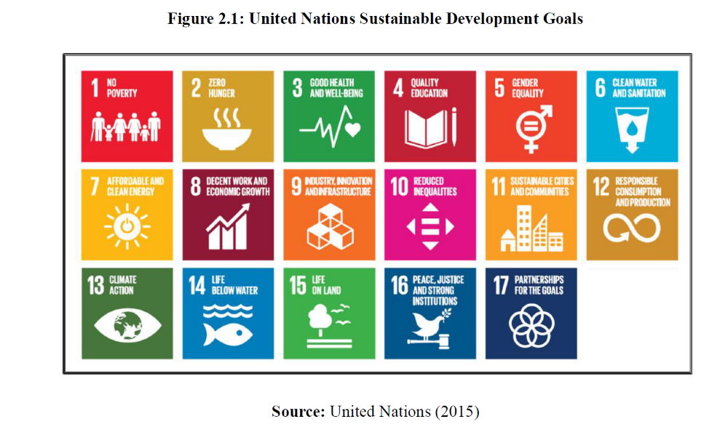

Slide 5
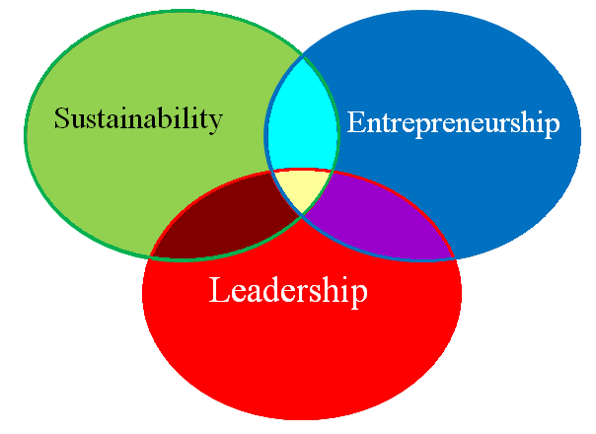
Sustainability-Entrepreneurship-Leadership Framework (SELF)
Unicorns and tech firms apply technology to resolve E&S challenges
MLA
Leadership
ESG corporate leaders are well recognized nowadays
Transform entrepreneurial spirit to establish a corporate culture

Slide 6
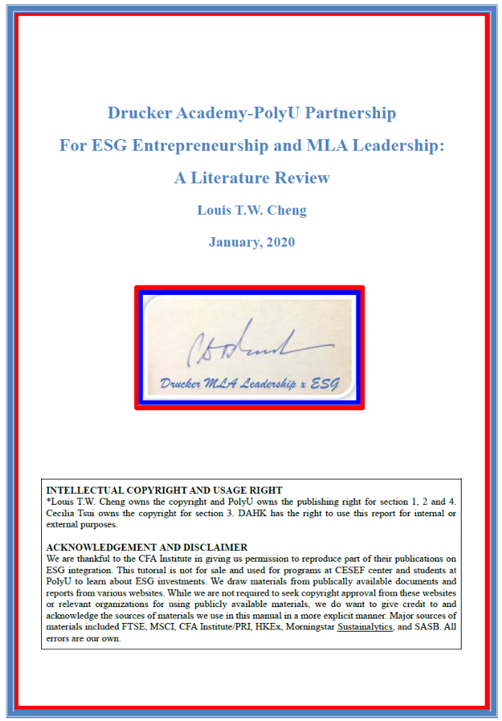

Slide 7
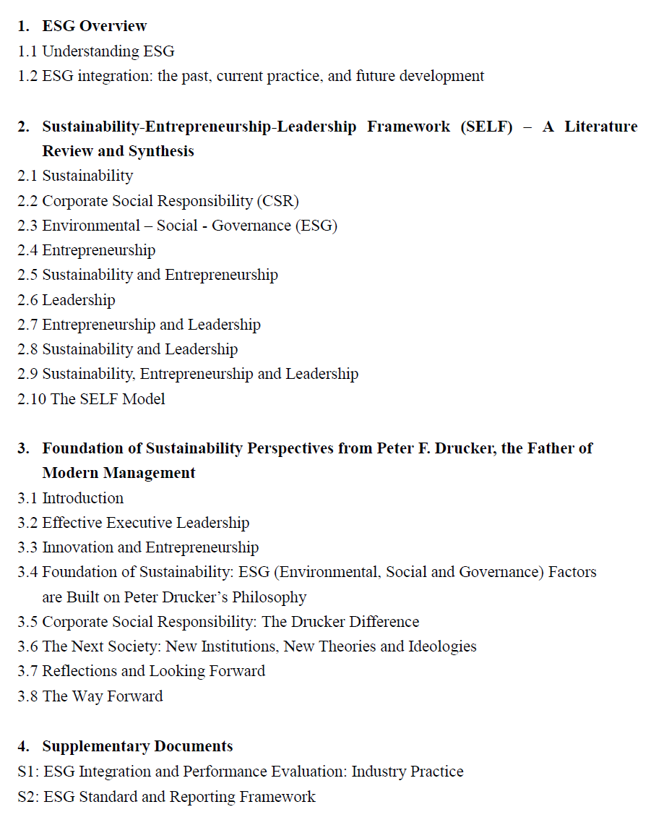
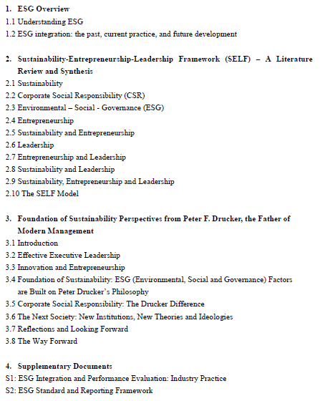
Table of Content

Slide 8
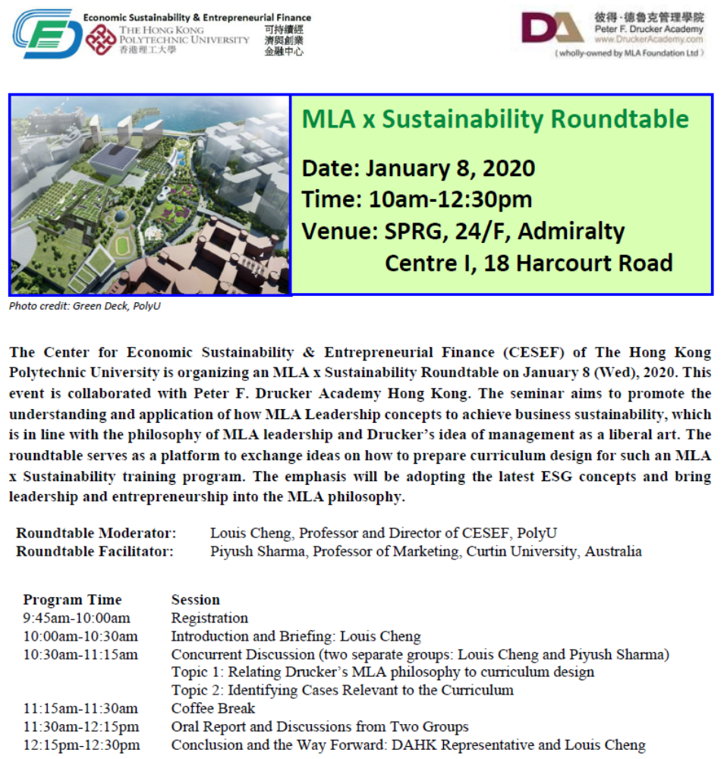
It is your turn now…

Slide 9
Roundtable Objective
Under this Drucker Academy-PolyU Partnership for ESG Entrepreneurship and MLA Leadership, we expect to organize two roundtables.
This is the first one (R1) and we aim to explore curriculum design for a three 3-hr seminars. Please be reminded that it is the design preparation only.
The second roundtable (R2) will incorporate the input from R1 and then design the syllabi for the 3 subjects and a possible way forward for the Executive Master in MLA-ESG leadership.
We will also deliver the research report by R2.
Survey instrument on MLA and ESG practice will be developed for all three seminars for participants to fill in.
The design for the three three-hour seminars is agreed on April 24, 2019 by both DAHK and PolyU as follows
Table 1: Subject Design and Work Allocation
Subject | Description | DAHK | PolyU
Introductory level: | 2 hours on Management as a Liberal Art (MLA) (DAHK) + and 1 hour on concept of ESG Entrepreneurial Leadership (PolyU). | Management as a Liberal Art: 2 hours | concept of ESG Entrepreneurial Leadership: 1 hour
Intermediate level: | 1 hour on introduce ESG, Entrepreneurial Leadership (PolyU) and MLA + 2 hours on ESG Entrepreneurial Leadership (DAHK/PolyU). | MLA + ESG Entrepreneurial Leadership: 2 hours (joint) | introduce ESG, Entrepreneurial Leadership: 1 hour MLA + ESG Entrepreneurial Leadership: 2 hours (joint)
Advanced level: | 3 case studies on companies using MLA. (DAHK+PolyU) | 3 case studies on companies using MLA: 3 hours | N/A

Slide 10
DAHK Course Analysis: Learn from the Past (HKU SPACE/Centennial)
 | Course title | Selected | Remarks
CC1 | The Drucker Practice of Management | ✓ | DAHK
CC2 | Professional Ethics and Practice | ✓ | Louis
CC3 | Oriental Philosophies and Management | ✓ | DAHK
CC4 | The Art of Communication in Management | X
CC5 | Purposeful Leadership in Society | ✓ | Louis/Piyush
CC6 | Strategic Thinking in Management | X
CC7 | Management in Practice | X
CCE1 | Big Data for Business Management | X
CCE2 | Customer-Focused Business and Marketing | X
CCE3 | Financial Management | X
CCE4 | Innovation and Entrepreneurship | ✓ | Louis
CCE5 | Managing for Social and Environmental Sustainability | ✓ | Louis/Piyush
Notes: CC: Compulsory Courses and CCE: Elective Courses

Slide 11
Appendix 1: Subject Description from HKU SPACE/Centennial
CC1- The Drucker Practice of Management:
The course “The Drucker Practice of Management” covers some key management concepts developed and advocated by Drucker. This course is integral to the program because of the centrality of his scholarship and practice to the field of management generally. He sees management as an inclusive task which is to be performed by managers at all levels in an organization and within each of its different functions. This requires training and preparing managers at all levels through effective practice. Drucker argued that an organization is more than just a convergence of resources; it is a living social entity, an integrated whole that can evolve, change and even transform. Communication - both formal and informal - and at all levels is key to the way change happens in organizations. Drucker recognised that communication involves relationships that require mutual participation through shared or recognised experience, as witnessed in the context of conventional practice, the environment and culture.

Slide 12
CC2- Professional Ethics and Practice:
“Professional Ethics and Practice” is designed to instil in students a critical thinking approach to many of the ethical concerns that members have to cope with in contemporary organizations. Emphasis will be placed on the manager’s social and environmental responsibilities and their accountability to a wide variety of stakeholders, including employees, customers and the public. Ethical dilemmas and decision-making frameworks and approaches at the personal, organizational and societal levels will be explored. Student engagement in real-world applications and issues are a critical part of the course.
CC3- Oriental Philosophies and Management:
The course “Oriental Philosophies and Management” will discuss and examine the most representative oriental philosophies widely used today and that play such an important role in the art and practice of management. In short, in a globalized economy, being well versed in Oriental Wisdom becomes a competitive edge if it allows students to better understand the mindsets of their Asian counterparts, with due acknowledgement made, through comparison and contrast, to established Western practices. This can help students form the right strategy in the relevant cultural context. A number of these principles are also to be found in a people-oriented and integrative approach to the practice of management as a liberal art.

Slide 13
CC5- Purposeful Leadership in Society:
The course “Purposeful Leadership in Society” integrates concepts and models from psychology, sociology, and organizational behavior. It takes a unique approach to discussing leadership in both traditional and modern contexts, in Eastern and Western cultures, as well as in theory and practice. Leadership calls for heightened self-awareness, interpersonal and team-working skills. Success in this area depends on the individual’s ability to motivate people to “punch above their weight”.
CCE4- Innovation and Entrepreneurship:
The course “Innovation and Entrepreneurship” examines innovation and entrepreneurship within a broad societal context, as well as within the context of specific organizational actions and decisions. In terms of the former, consideration is given to various drivers for innovation, ranging from Drucker’s societal imperative for innovation to concerns for sustainability and global economic development. As regards specific organizational actions, the course will provide students with the conceptual framework and tactics necessary for recognizing innovation and entrepreneurship opportunities and then devising strategies to successfully seize them.

Slide 14
CCE5- Managing for Social and Environmental Sustainability:
“Managing for Social and Environmental Sustainability” explores the long-term perspectives that underpin sustainability and its multidisciplinary connections to history, ethics, legal systems, governments, scientific developments and so on. As the former Secretary-General to the United Nations, Ban Ki-Moon has remarked: “Climate change is destroying our path to sustainability. Ours is a world of looming challenges and increasingly limited resources. Sustainable development offers the best chance to adjust our course”. Being community-focused, Sustainability involves major environmental, social and economic challenges that are all facing humanity in the 21st century. It is predicated on the concepts of innovation and experimentation as well as communication and community engagement.
~ Thank You ~

